Slide 1

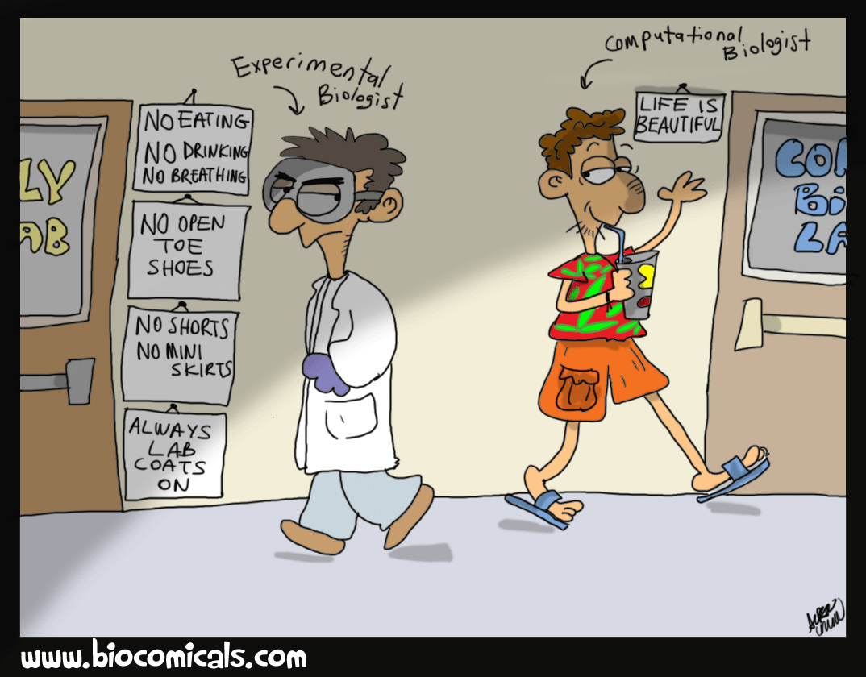

……..CENTRE OF EXCELLENCE
UNIVERSITY OF MAIDUGURI
MCB 204
BIOINFORMATICS
??????
CENTRE OF EXCELLENCE

Slide 2
UNIVERSITY OF MAIDUGURI CENTRE OF EXCELLENCE
Outline:
Sequence Alignment;
Pairwise Sequence Alignment ■
Multiple Sequence Alignment ■
Global Alignment ■
Local Alignment ■
Computing/scoring alignments ■
Database Similarity Searching;
BLAST■
FASTA ■

Slide 3
UNIVERSITY OF MAIDUGURI CENTRE OF EXCELLENCE
Sequence Alignment- Definition
Sequence alignment is a way of arranging of two or more sequences of DNA, RNA or protein to identify and highlight regions of similarity.
The similarity may indicate the functional, structural and evolutio-nary significance of the sequence.
The sequence alignment is made between a known sequence and unknown sequence or between two unknown sequences.
The known sequence is called reference sequence.
The unknown sequence is called query sequence.

Slide 4
UNIVERSITY OF MAIDUGURI CENTRE OF EXCELLENCE
Types of Alignment
According to the number of sequences:
i. Pair-wise alignment
(Global and local sequence alignment)
ii. Multiple alignment

Slide 5
UNIVERSITY OF MAIDUGURI CENTRE OF EXCELLENCE
Pair-wise Sequence Alignment
Pair-wise sequence alignment only compares two sequences at a time.
It is concerned with finding the best-matching of protein (amino acid) or DNA (nucleic acid) sequences.
Typically, the purpose of this is to find homologues (relatives) of a gene or gene-product in a database of known examples.
This information is useful for answering a variety of biological questions such as;
i. The study of molecular evolution.

Slide 6
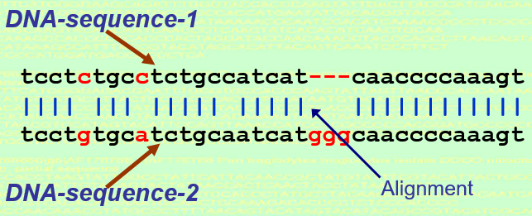
UNIVERSITY OF MAIDUGURI CENTRE OF EXCELLENCE
Pair-wise Sequence Alignment
A pairwise alignment consists of a series of paired bases, one base from each sequence.
There are three types of pairs:
i. Matches: the same nucleotide appears in both sequences.
ii. Mismatches: different nucleotides are found in the two sequences.
Mismatches in the alignment correspond to mutations
iii. Gaps: a base in one sequence and a null base in the other.
Gaps correspond to insertions or deletions.

Slide 7
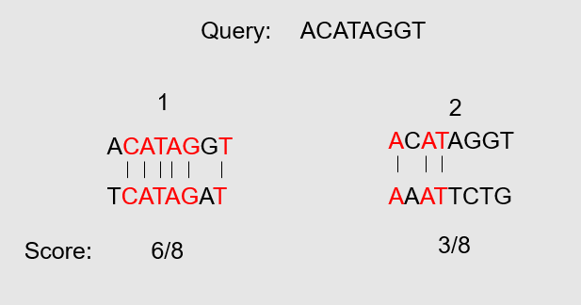
UNIVERSITY OF MAIDUGURI CENTRE OF EXCELLENCE
Pair-wise Sequence Alignment
Algorithm used are:
i. Needleman-Wunsch algorithm and Smith-Waterman algorithm
ii. BLAST (Basic Local Alignment Search TooL)
determining similar regions between two nucleotide or protein sequences.
optimality is based on SCORE.
The BLAST algorithm is much more efficient, much faster, ease of use, statistical rigor than other approaches.

Slide 8
UNIVERSITY OF MAIDUGURI CENTRE OF EXCELLENCE
Multiple Sequence Alignment
Multiple sequence alignment (MSA) is a sequence alignment of three or more biological sequences, generally protein, DNA, or RNA.
Multiple alignment methods try to align all of the sequences in a specified set.
The most popular multiple alignment tool is ClustalW, MUSCLE, PROBCONS, MAFFT, and T-Coffee

Slide 9
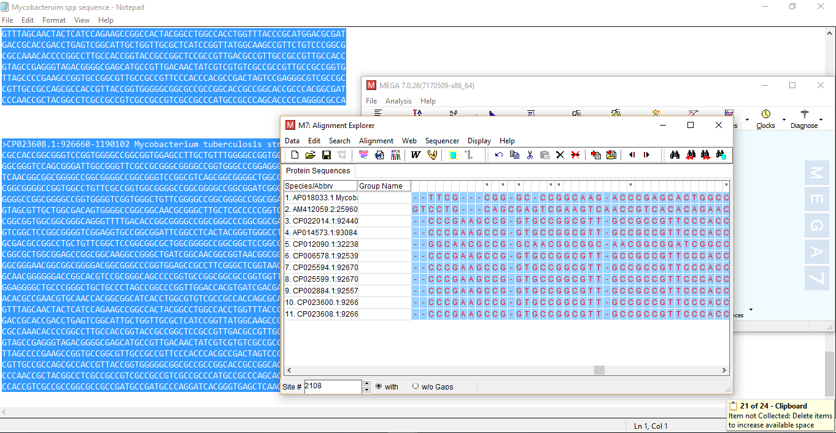
UNIVERSITY OF MAIDUGURI CENTRE OF EXCELLENCE
Multiple alignment

Slide 10
UNIVERSITY OF MAIDUGURI CENTRE OF EXCELLENCE
Types of Sequence Alignment
According to sequence coverage:
i. Global sequence alignment
ii. Local sequence alignment

Slide 11

UNIVERSITY OF MAIDUGURI CENTRE OF EXCELLENCE
Global Alignment
Global Alignment : is a matching the residues of two sequences across their entire length.
That is, alignment is carried out from beginning to end of both sequences to find the best possible alignment across the entire length between the two sequences.

Slide 12
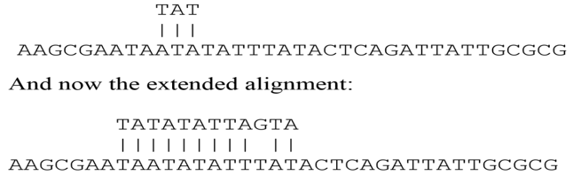
UNIVERSITY OF MAIDUGURI CENTRE OF EXCELLENCE
Local alignment
Local alignment is a matching of two sequence from regions which have more similarity with each other.
It does not assume that the two sequences in question have similarity over the entire length.
It only finds local regions with the highest level of similarity between the two sequences and aligns these regions without regard for the alignment of the rest of the sequence regions.

Slide 13
UNIVERSITY OF MAIDUGURI CENTRE OF EXCELLENCE
Database Similarity Searching
A main application of pairwise alignment is retrieving biological sequences in databases based on similarity.
This process involves submission of a query sequence and performing a pairwise comparison of the query sequence with all individual sequences in a database.
There two major algorithms for performing database searches: BLAST and FASTA.

Slide 14
UNIVERSITY OF MAIDUGURI CENTRE OF EXCELLENCE
BLAST (Basic Local Alignment Search Tool)
The most common local alignment tool developed by Altschul et al. (1990)
It is an algorithm for comparing primary biological sequence information, such as the amino-acid sequences of different proteins or the nucleotides of DNA sequences.
A BLAST search enables a researcher to compare a query sequence with a library or database of sequences, and identify library sequences that resemble the query sequence above a certain threshold.

Slide 15
UNIVERSITY OF MAIDUGURI CENTRE OF EXCELLENCE
Examples of question that researchers use BLAST to answer:
Which bacterial species have a protein that is related in lineage to a certain protein with known amino-acid sequence?

Slide 16
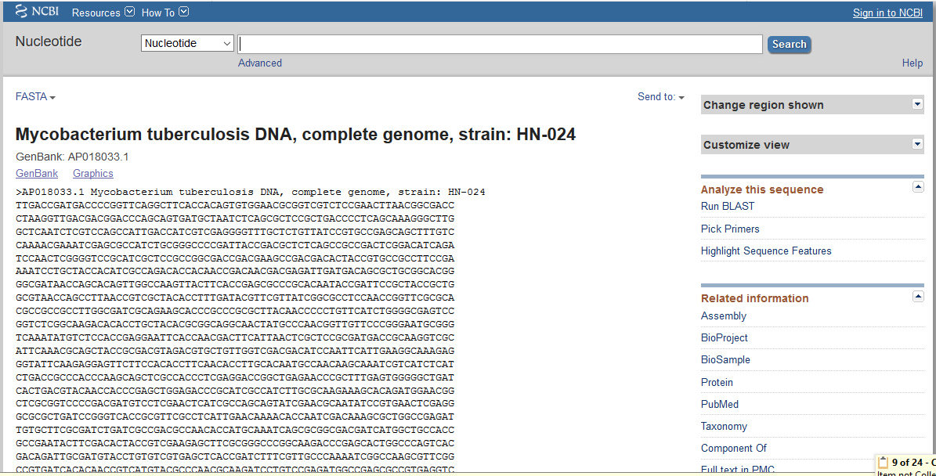
UNIVERSITY OF MAIDUGURI CENTRE OF EXCELLENCE
The BLAST algorithm and the computer program that implements it were developed by Stephen Altschul, Warren Gish, and David Lipman at the U.S. National Center for Biotechnology Information (NCBI)
It is available on the NCBI website.

Slide 17
UNIVERSITY OF MAIDUGURI CENTRE OF EXCELLENCE
FASTA (First fast sequence searching algorithms)
Developed by David J. Lipman and William R. Pearson in 1985.
It’s a kind of format and algorithm for comparing a query
sequence against a database.

Slide 18
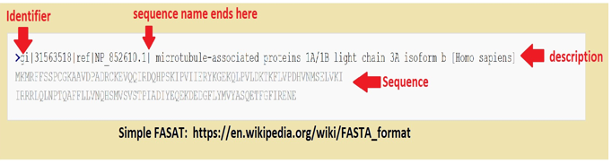
FASAT Format:
FASTA format is the standard format in the field of bioinformatics to represent either nucleotide sequences or peptide sequences.
This format is single-letter code and it allows sequence names and comments
FASAT consists of a single-line description at the beginning followed by sequence data in multiple lines.
The length of the each chunk (line) of the sequence must not exceeds 80 characters.
Sequence identifiers are defined by a standard called NCBI

Slide 19
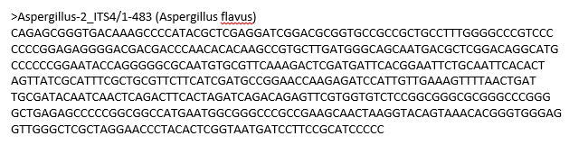
UNIVERSITY OF MAIDUGURI CENTRE OF EXCELLENCE
FASTA Format:
A GenBank entry, (query and database sequences) entry:

