Slide 1

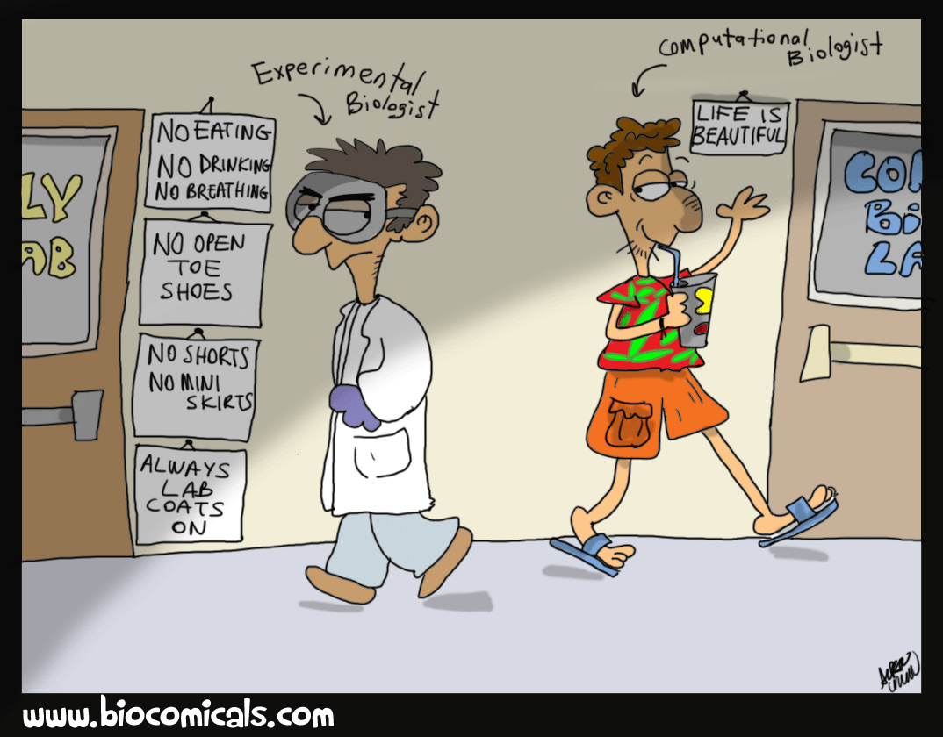

……..CENTRE OF EXCELLENCE
UNIVERSITY OF MAIDUGURI
MCB 204
BIOINFORMATICS
??????
CENTRE OF EXCELLENCE

Slide 2
UNIVERSITY OF MAIDUGURI CENTRE OF EXCELLENCE
Practical 1:
Analyzing DNA Sequence using NCBI Website and MEGA:
NCBI Website:
Database searching and retrieval of sequences from GenBank in NCBI.
Algorithms/tools for performing database searches: BLAST and FASTA (a kind of format and algorithm).
MEGA:
Performing multiple sequence alignment using MUSCLE
Constructing of tree

Slide 3
UNIVERSITY OF MAIDUGURI CENTRE OF EXCELLENCE
Brainstorming:
1: Download and install MEGA 7 software.
2: State and search nucleotide sequence of interest (gene X) from NCBI nucleotide database.
3: Copy the sequence and save/add in Notepad.
4: (i) Search 10 related sequences (e.g gene “X” from different strains) from NCB1 nucleotide database and copy the selected sequence and save in notepad.
(ii) Perform a multiple sequence alignment and state their identity.

Slide 4
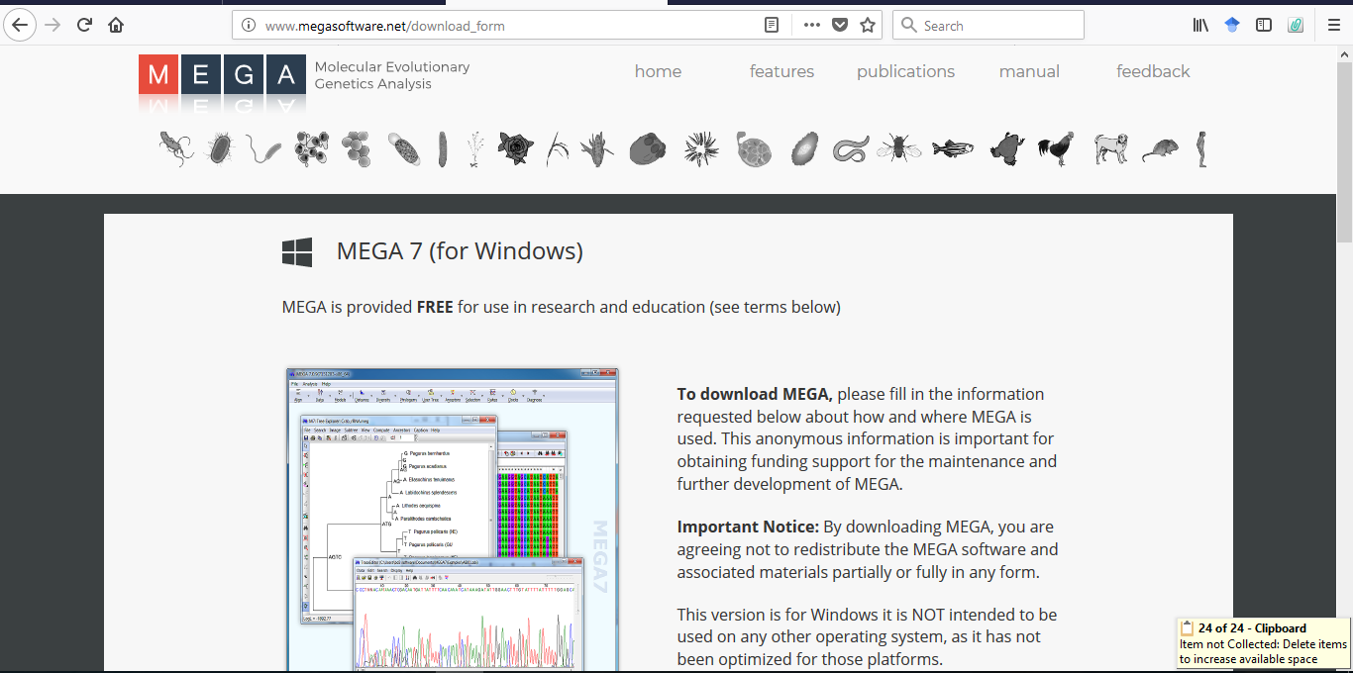
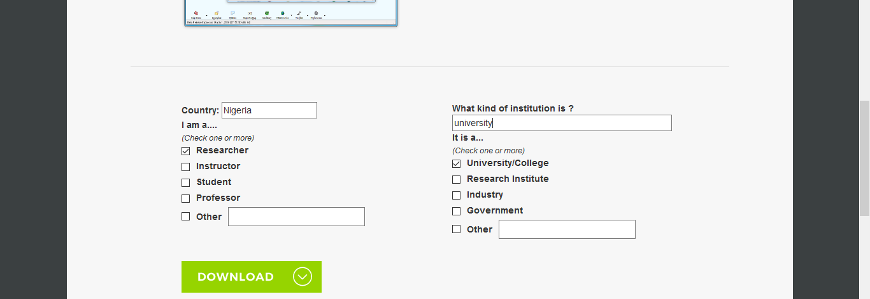
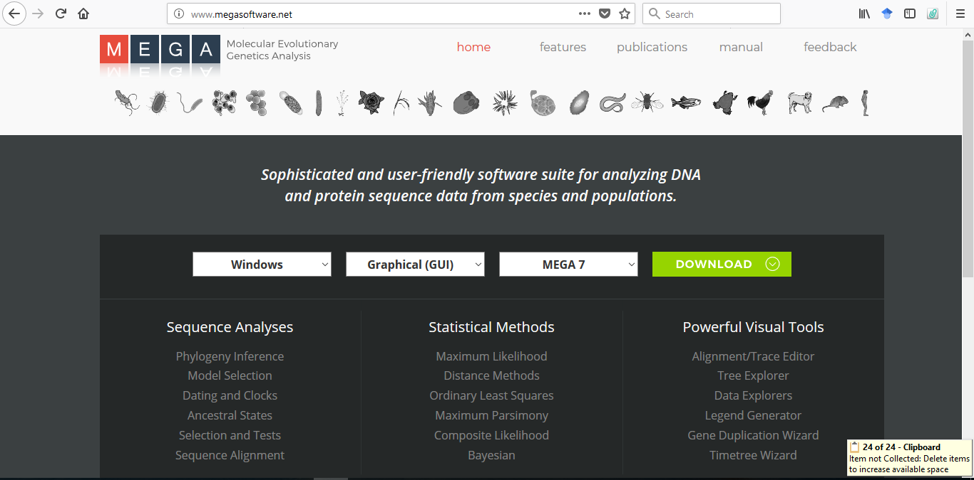
UNIVERSITY OF MAIDUGURI CENTRE OF EXCELLENCE
1. Download and install MEGA software.

Slide 5
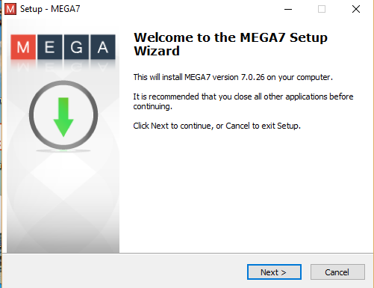
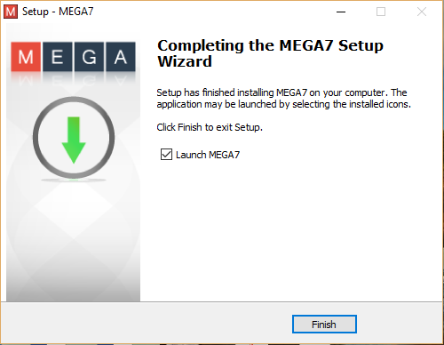
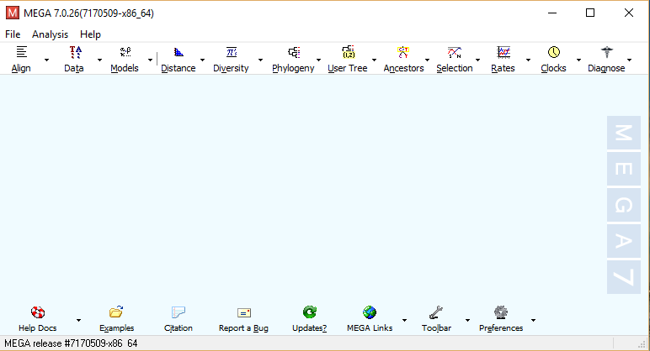
UNIVERSITY OF MAIDUGURI CENTRE OF EXCELLENCE

Slide 6
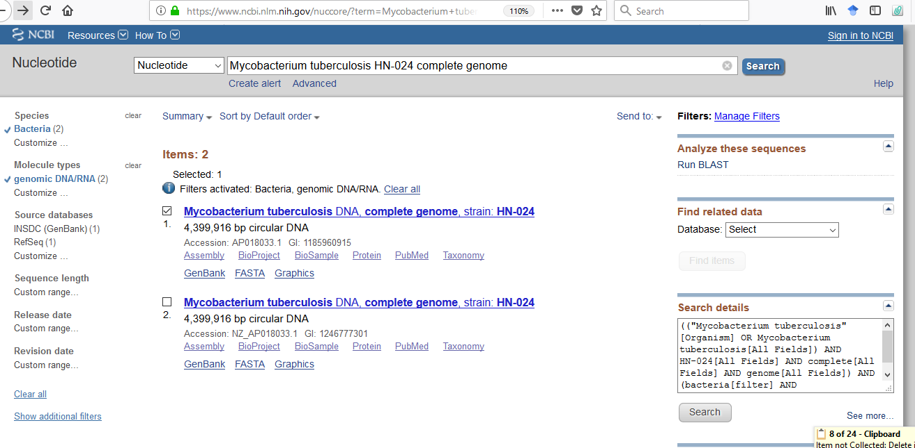
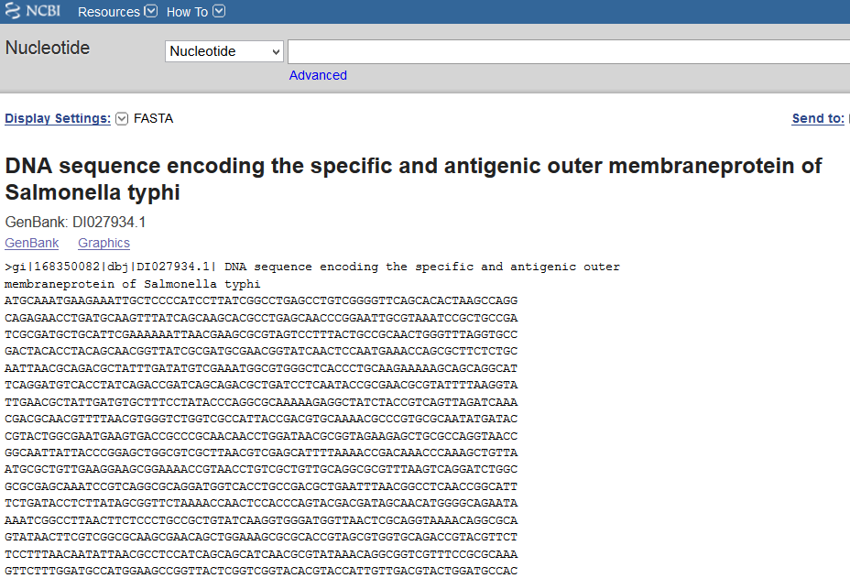
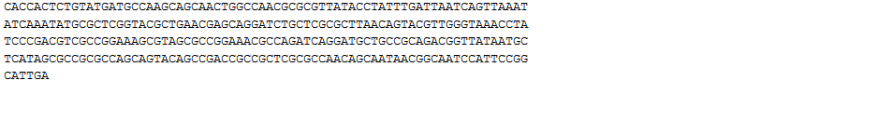
UNIVERSITY OF MAIDUGURI CENTRE OF EXCELLENCE
2. State and search nucleotide sequence of interest (gene X) from NCBI nucleotide database @www.ncbi.nlm.nih.gov/Genbank/
Organism/gene of interest: Mycobacterium tuberculosis DNA, complete genome. Strain HN-024
Then select and clicked on FASTA to generate the sequences

Slide 7
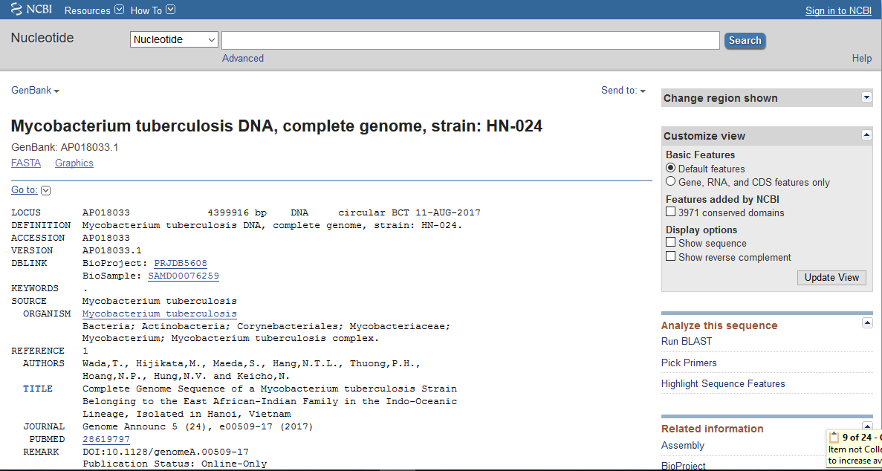
UNIVERSITY OF MAIDUGURI CENTRE OF EXCELLENCE
Click on FASTA to generate the sequences

Slide 8
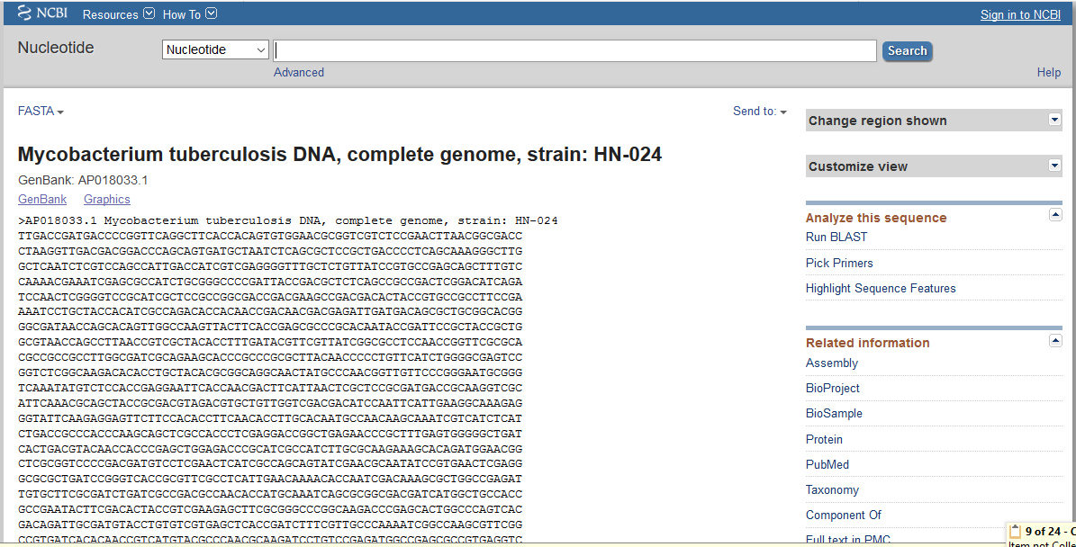
UNIVERSITY OF MAIDUGURI CENTRE OF EXCELLENCE
FASTA generated sequences of Mycobacterium tuberculosis DNA, complete genome. Strain HN-024

Slide 9
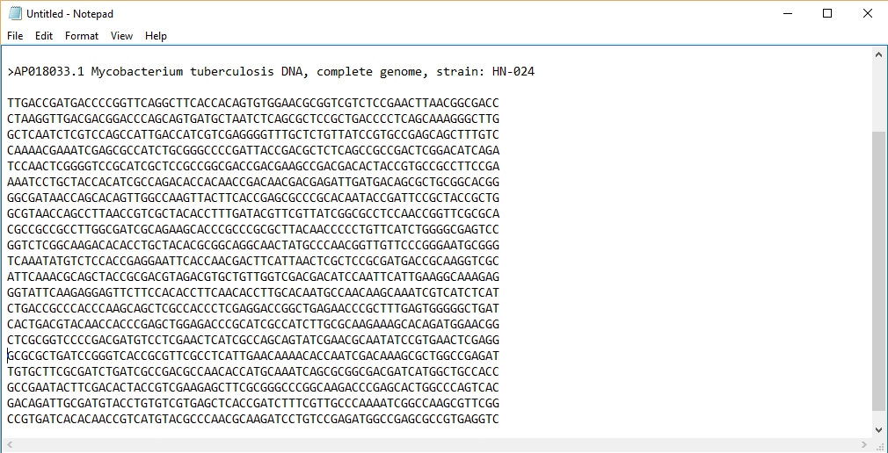
UNIVERSITY OF MAIDUGURI CENTRE OF EXCELLENCE
3. Copy the sequence and save/add in notepad
The sequence of gene of interest is copied from the NCBI database and pasted on the notepad, then save.

Slide 10

UNIVERSITY OF MAIDUGURI CENTRE OF EXCELLENCE
4(i) Search 10 related sequences (e.g gene “X” from different strains) from NCB1 nucleotide database and copy the selected sequence and save in notepad.
To search for the related genes, BLAST is run.

Slide 11
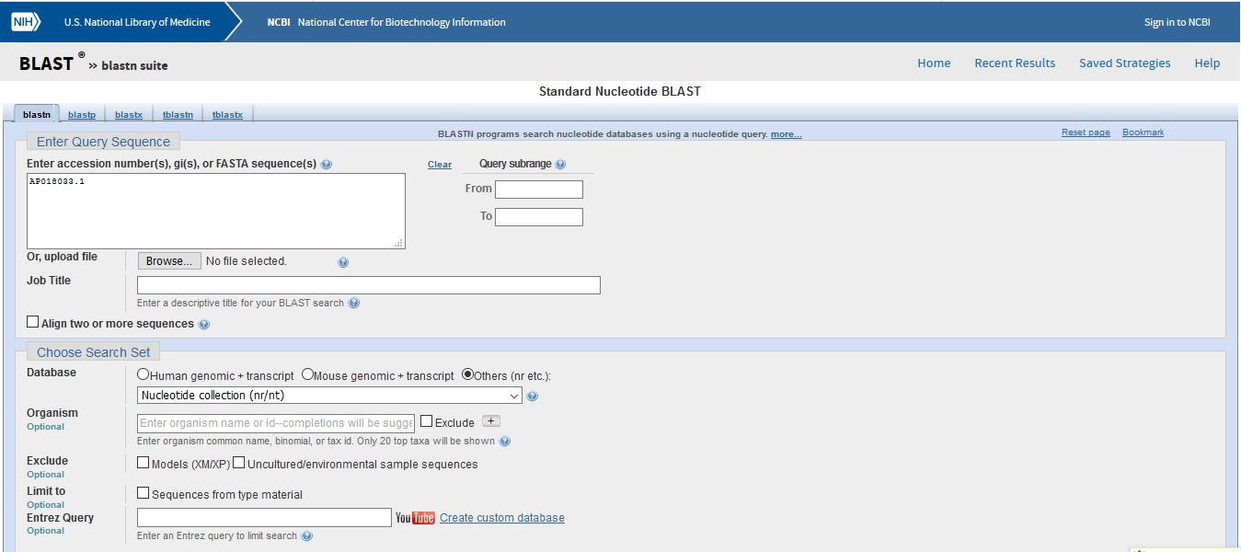
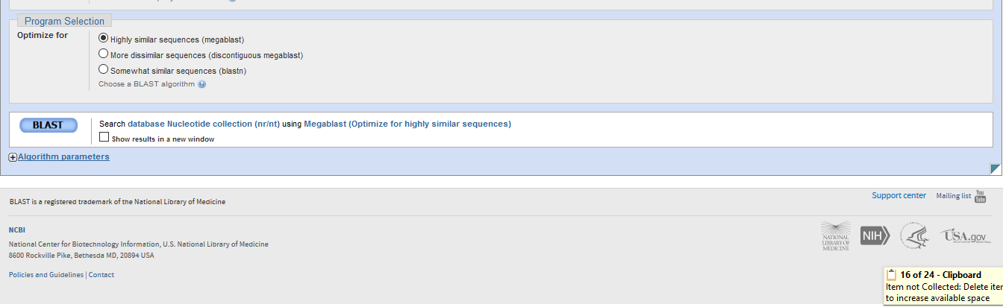
UNIVERSITY OF MAIDUGURI CENTRE OF EXCELLENCE
BLAST is run

Slide 12
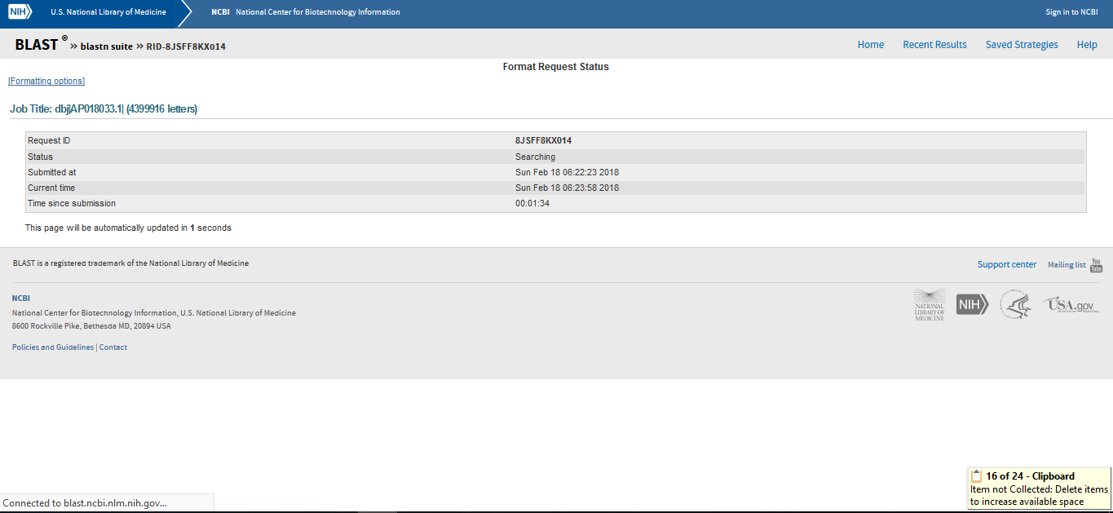
UNIVERSITY OF MAIDUGURI CENTRE OF EXCELLENCE
BLAST is run

Slide 13
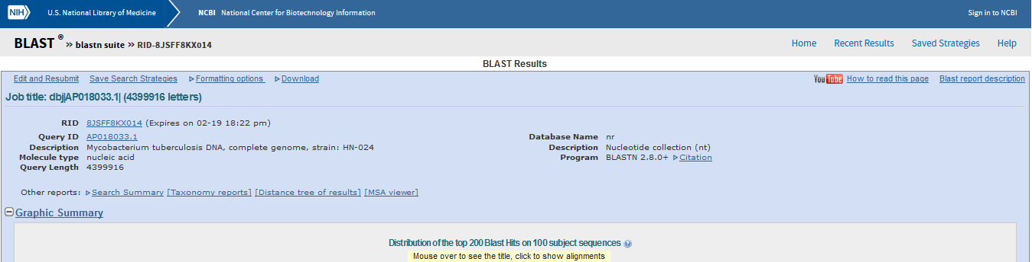
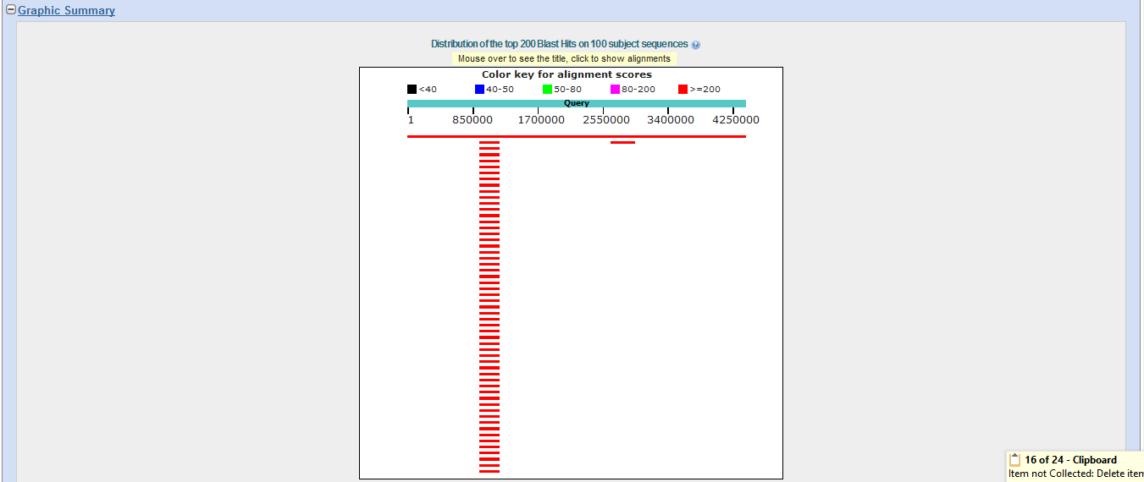
UNIVERSITY OF MAIDUGURI CENTRE OF EXCELLENCE
BLAST is run

Slide 14
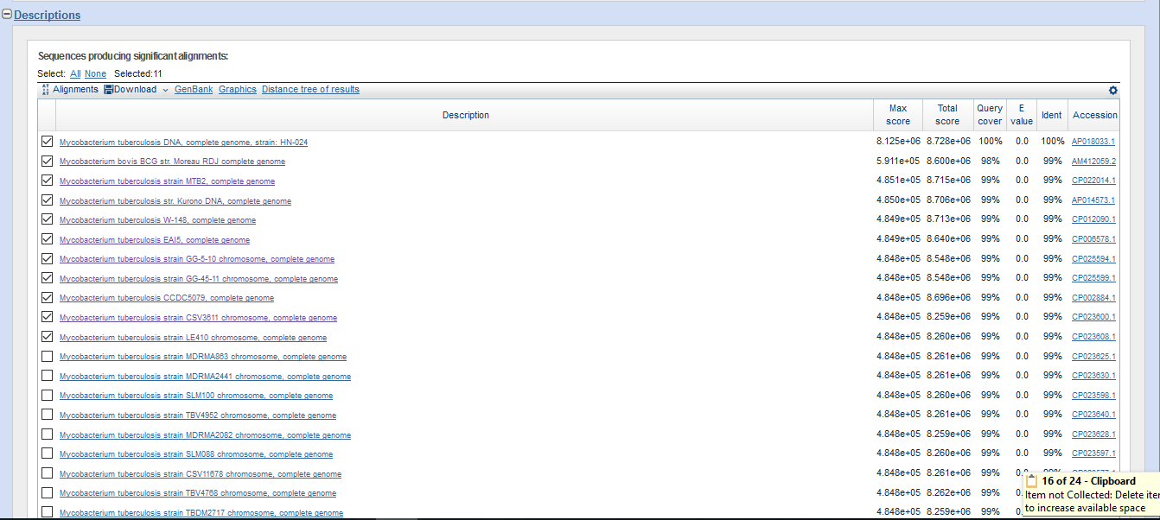
UNIVERSITY OF MAIDUGURI CENTRE OF EXCELLENCE
This slide shows the selected 10 related genes from the NCBI database

Slide 15
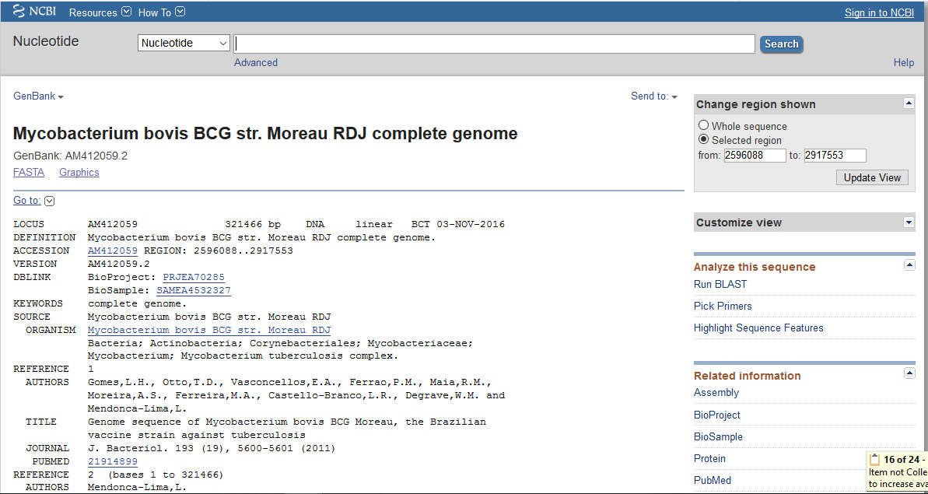
UNIVERSITY OF MAIDUGURI CENTRE OF EXCELLENCE
Then select and clicked on FASTA to generate the sequences of each of the 10 related strains

Slide 16
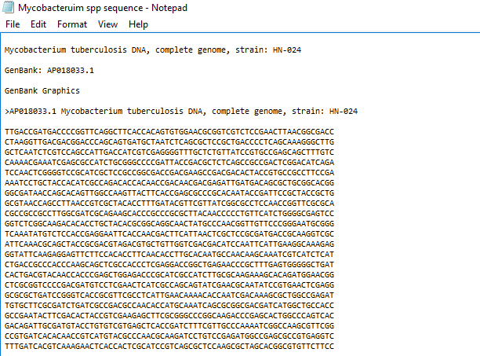
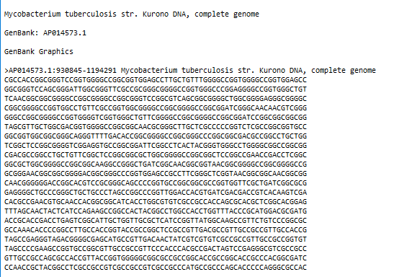
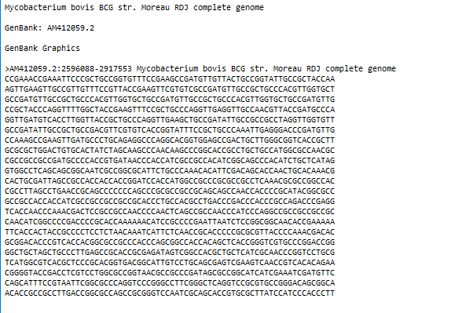
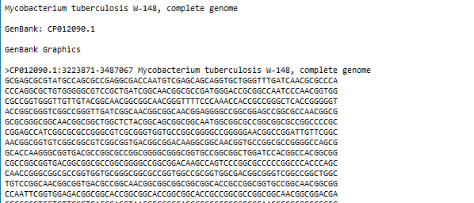
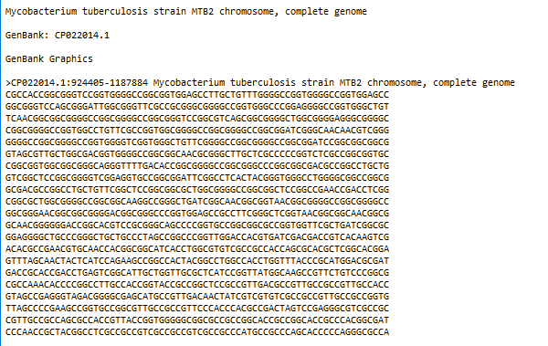
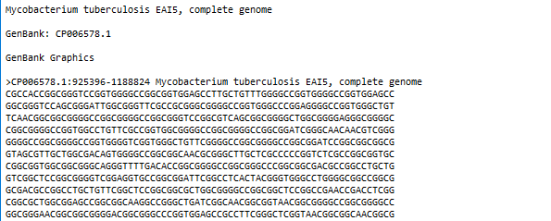
UNIVERSITY OF MAIDUGURI CENTRE OF EXCELLENCE
The sequences of the strain of interest (gene X) + 10 related species from the NCBI database are now copied and saved on notepad

Slide 17
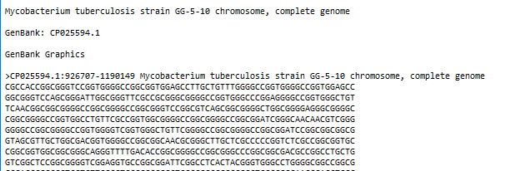
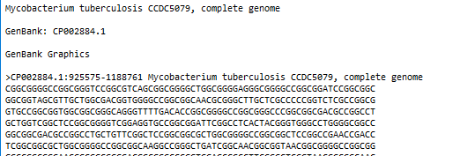
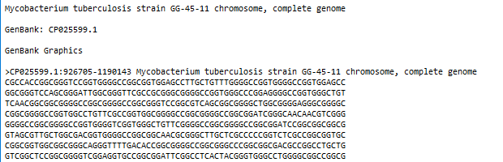
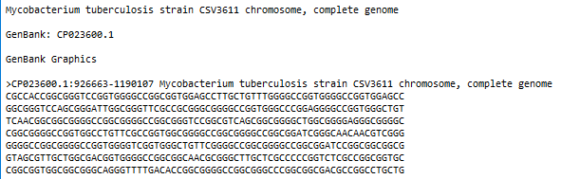
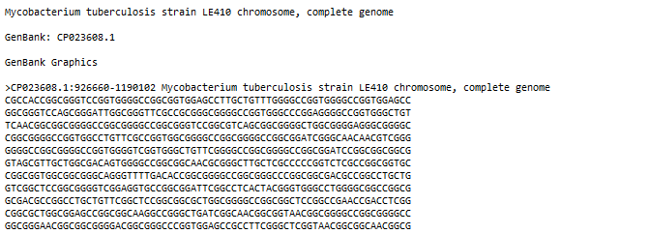
UNIVERSITY OF MAIDUGURI CENTRE OF EXCELLENCE

Slide 18
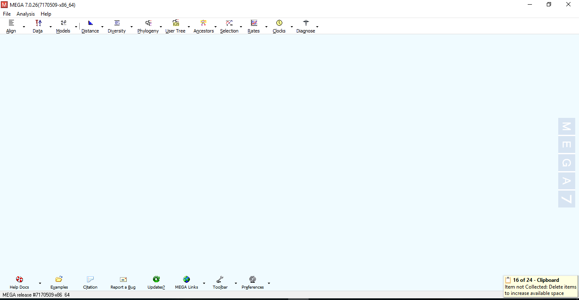
UNIVERSITY OF MAIDUGURI CENTRE OF EXCELLENCE
4(ii). Perform a multiple sequence alignment and state their identity.
For multiple sequence alignment, MEGA is used.

Slide 19
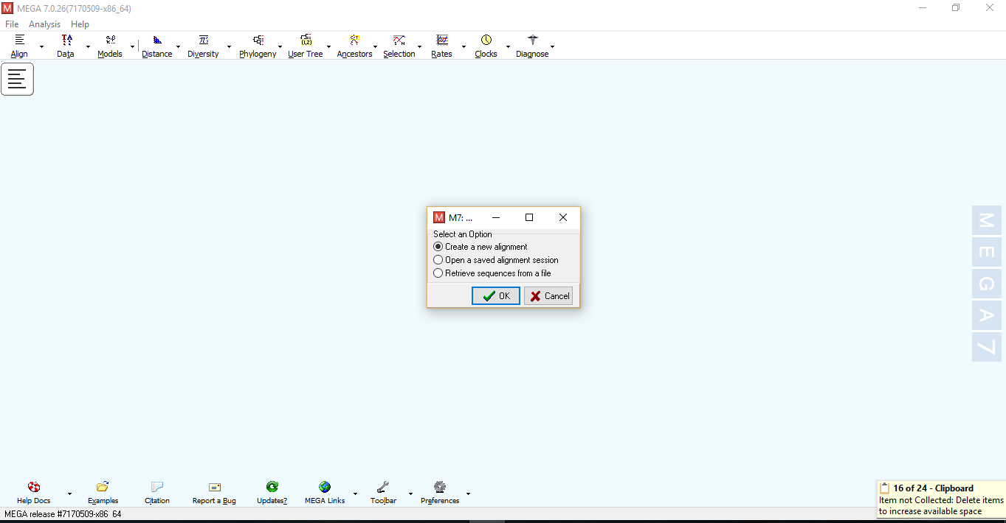
UNIVERSITY OF MAIDUGURI CENTRE OF EXCELLENCE
Click on Align and select Edit/build alignment to create a new alignment

Slide 20
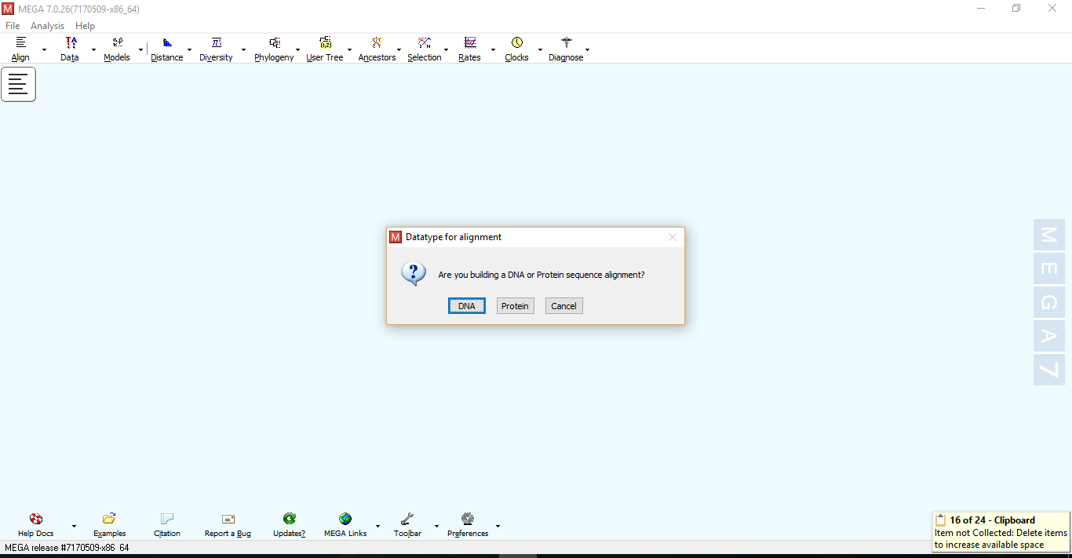
UNIVERSITY OF MAIDUGURI CENTRE OF EXCELLENCE
Click on DNA to build nucleotide sequence alignment

Slide 21
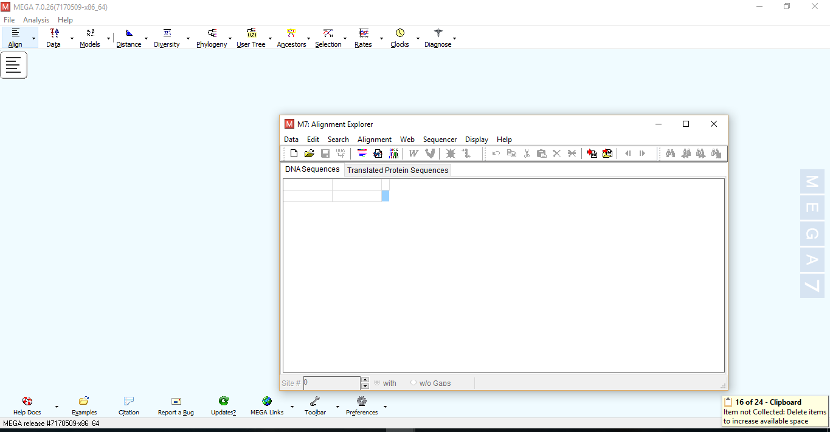
UNIVERSITY OF MAIDUGURI CENTRE OF EXCELLENCE
MEGA Alignment explorer

Slide 22
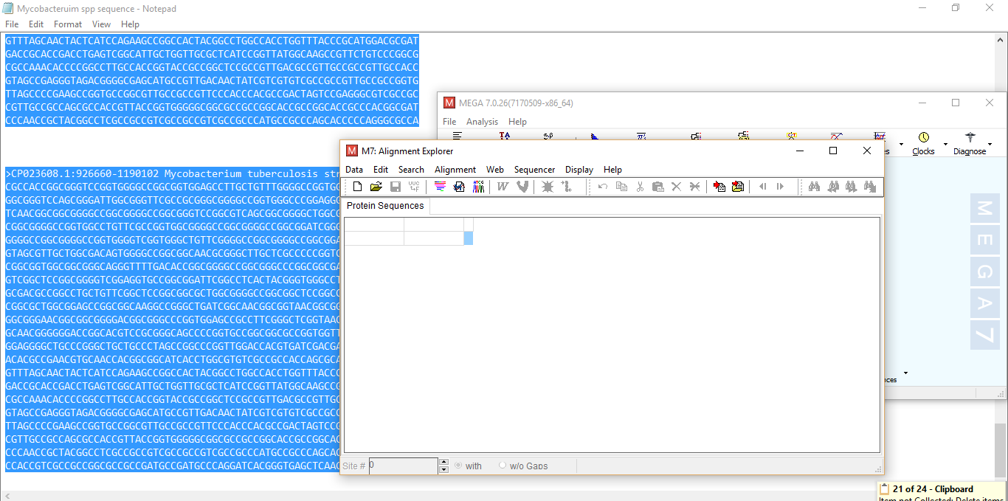
UNIVERSITY OF MAIDUGURI CENTRE OF EXCELLENCE
The sequences of the strain of interest (gene X) + 10 selected/related species from the NCBI database are now copied from notepad and pasted on Alignment explorer

Slide 23
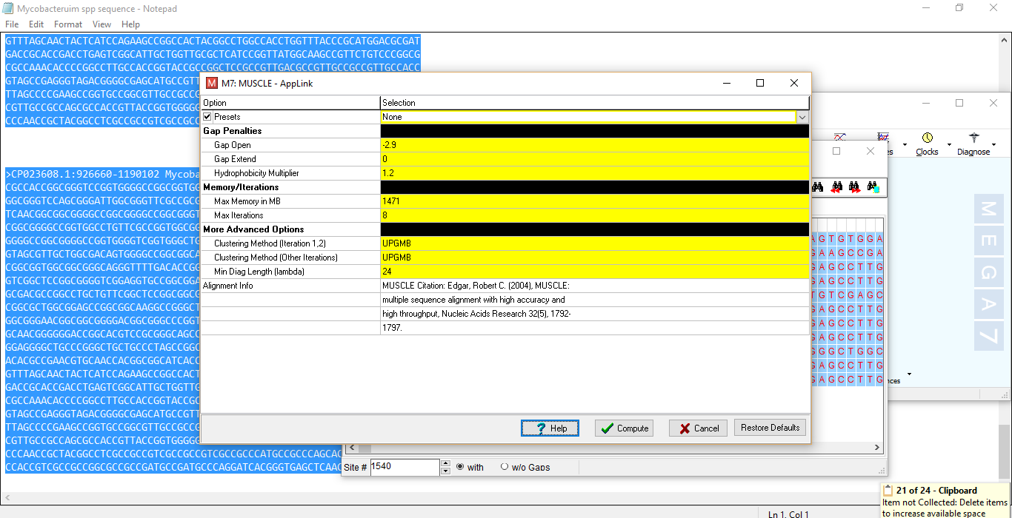
UNIVERSITY OF MAIDUGURI CENTRE OF EXCELLENCE
Click on compute

Slide 24
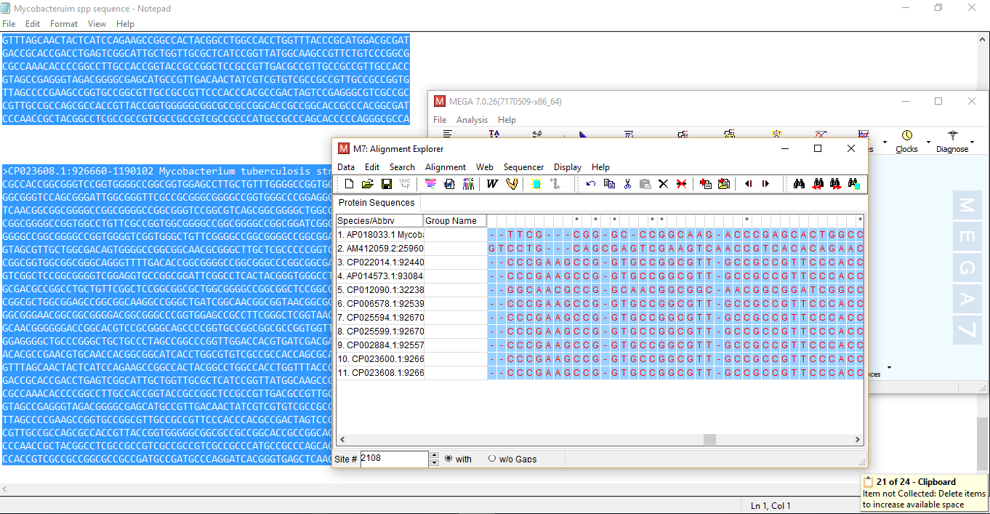
UNIVERSITY OF MAIDUGURI CENTRE OF EXCELLENCE
This shows the result for sequence alignments/alignment is done

Slide 25
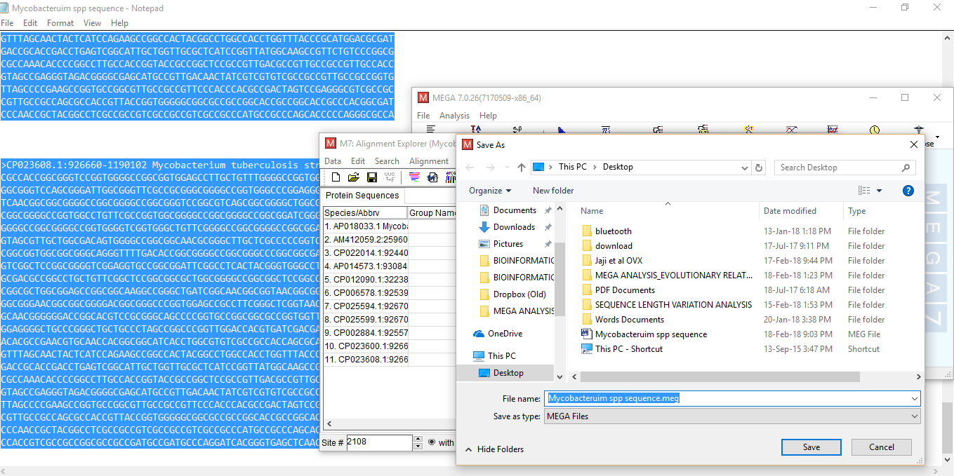
UNIVERSITY OF MAIDUGURI CENTRE OF EXCELLENCE
Click on Data
-Export alignment
-Select MEGA format and save on your window

Slide 26
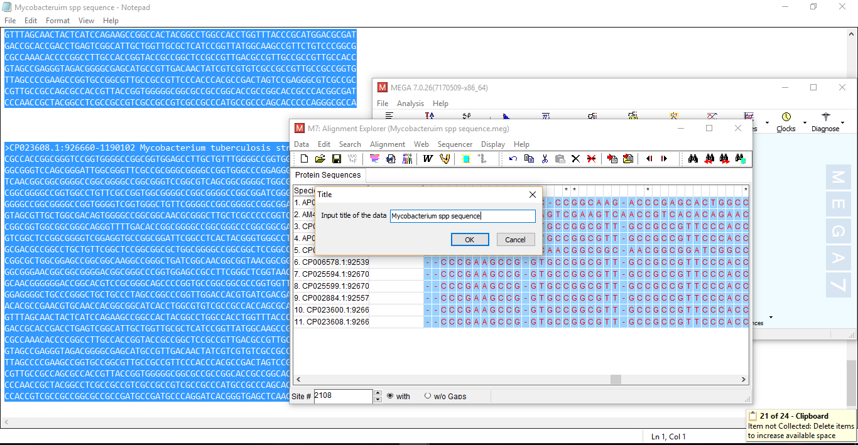
UNIVERSITY OF MAIDUGURI CENTRE OF EXCELLENCE

Slide 27
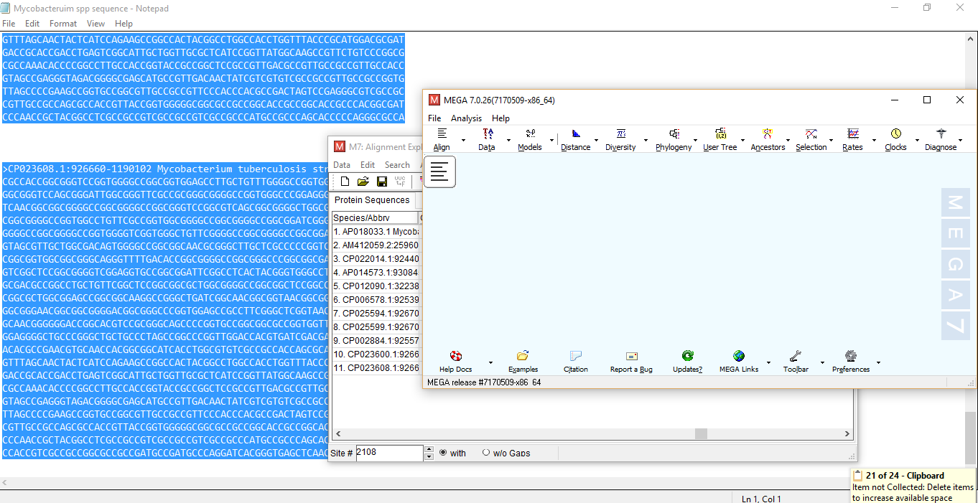
UNIVERSITY OF MAIDUGURI CENTRE OF EXCELLENCE
Construct phylogenetic tree:
-Click on phylogeny, select tree

Slide 28
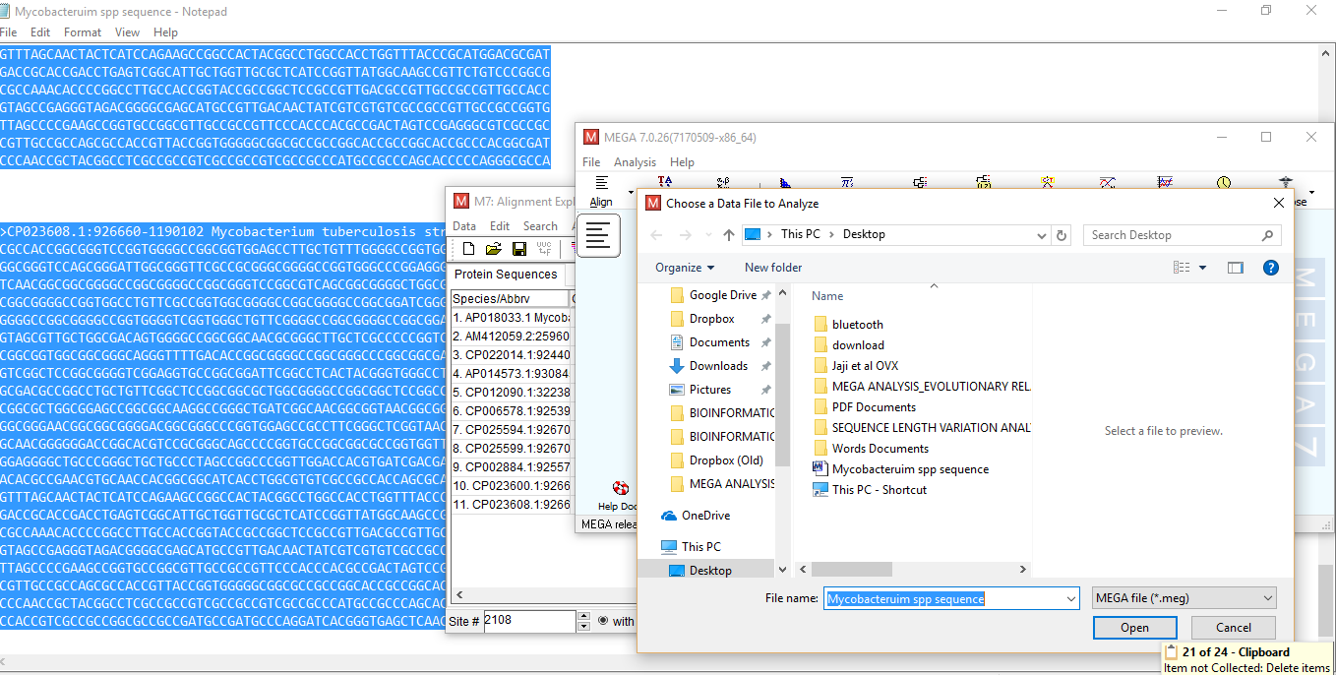
UNIVERSITY OF MAIDUGURI CENTRE OF EXCELLENCE
-Click on open

Slide 29
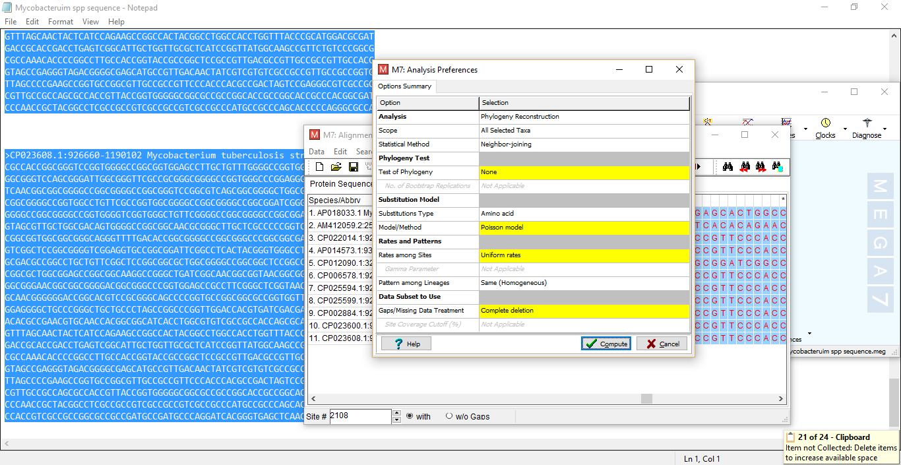
UNIVERSITY OF MAIDUGURI CENTRE OF EXCELLENCE
-Click on compute

Slide 30
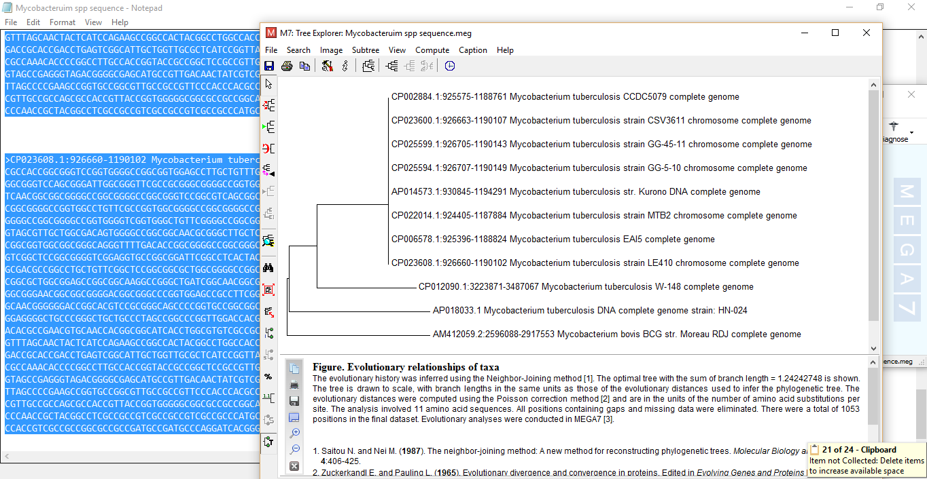
UNIVERSITY OF MAIDUGURI CENTRE OF EXCELLENCE
This is the phylogenetic tree for the above comparison.

Slide 31
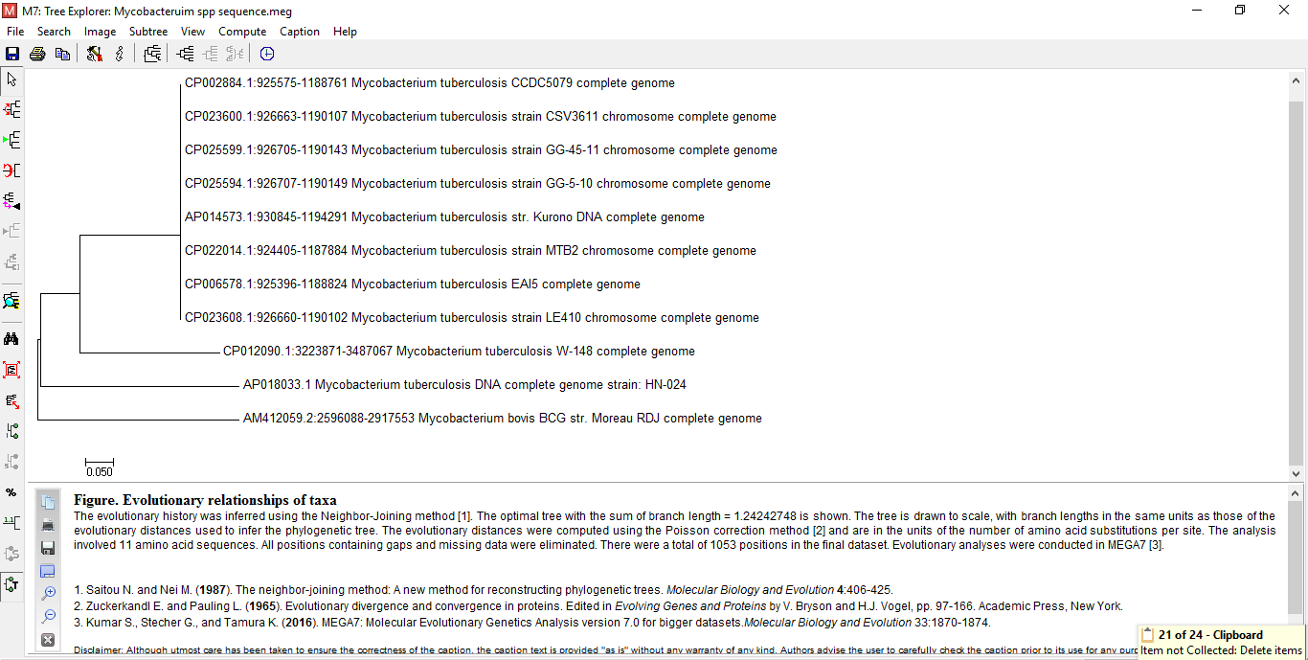
UNIVERSITY OF MAIDUGURI CENTRE OF EXCELLENCE
Phylogenetic relationship of Mycobacterial strains
The rooted tree was generated using Neighbor-joining method.

