Slide 1

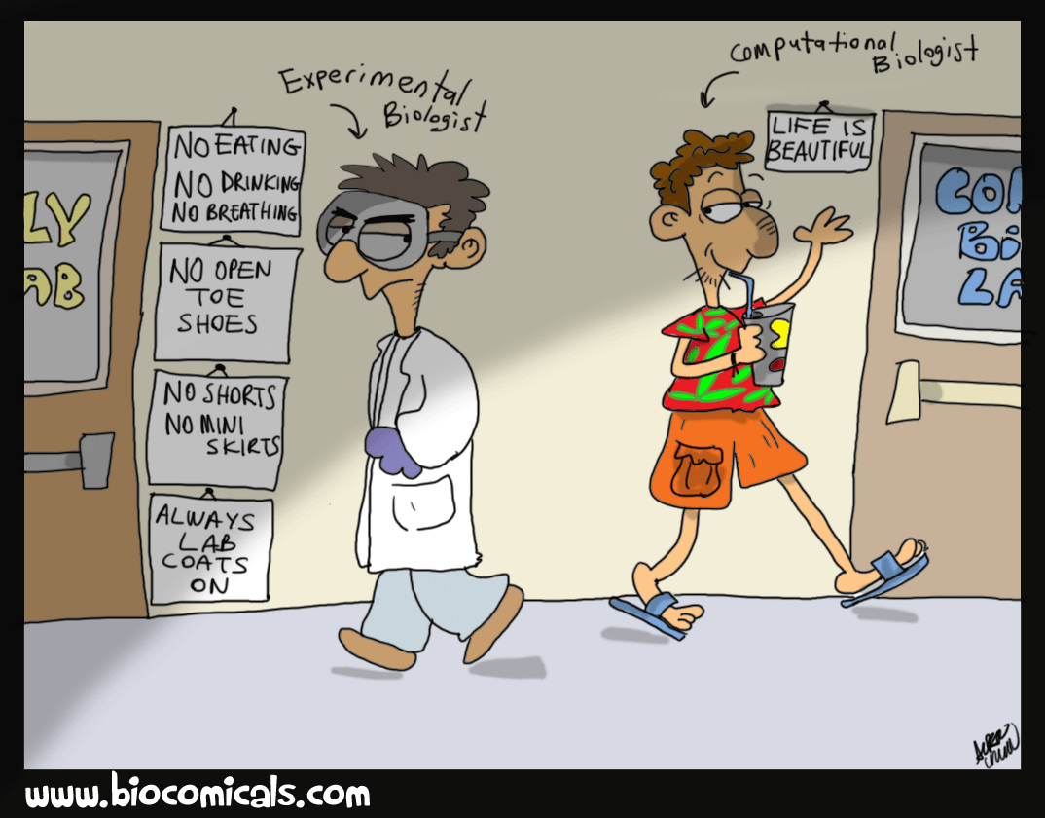

……..CENTRE OF EXCELLENCE
UNIVERSITY OF MAIDUGURI
MCB 204
BIOINFORMATICS
??????
CENTRE OF EXCELLENCE

Slide 2
UNIVERSITY OF MAIDUGURI CENTRE OF EXCELLENCE
Phylogenetic Tree
Phylogeny is the evolutionary history of a kind of organism.
In phylogenetic studies , the most convenient way to study the evolutionary relationship among a group of organism is through the illustration of phylogenetic tree.
DEFINITION– Phylogenetic tree is a branching diagram showing evolutionary relationship between organism and among various biological species, or genes from various organisms.
Based upon similarities and differences in their physical or genetic characteristics.
When comparing homologous genes in different species, the DNA sequences from closely related species are more similar to each other than the sequences from distantly related species .

Slide 3
UNIVERSITY OF MAIDUGURI CENTRE OF EXCELLENCE
The Purposes!
Understanding the origin of particular traits
Understanding the processes of molecular evolution
Origin of disease, e.g. where did humans get AIDs from?

Slide 4
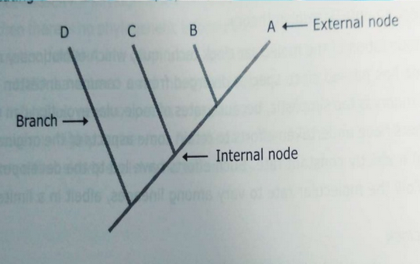
UNIVERSITY OF MAIDUGURI CENTRE OF EXCELLENCE
Characteristics:
Nodes can be internal or external.
Each internal node represent the last common ancestor of the two lineage.
External node (also termed as terminal node, leaves) represent the tip of the tree.
Node correspond to species, organism or sequences.

Slide 5
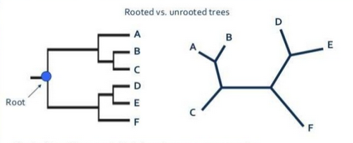
UNIVERSITY OF MAIDUGURI CENTRE OF EXCELLENCE
Types of Phylogenetic Tree
Rooted: has a root that denotes common ancestors of the leaves or branches of the tree.
Unrooted: radial-like structure. It doesn't denotes evolutionary path. It make an illustration about the leaves or branches

Slide 6
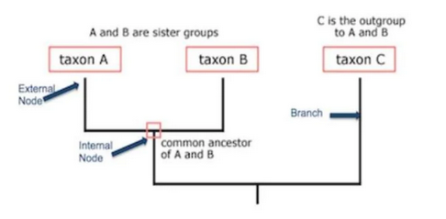
UNIVERSITY OF MAIDUGURI CENTRE OF EXCELLENCE
Anatomical description of the part of a phylogenetic tree

Slide 7
UNIVERSITY OF MAIDUGURI CENTRE OF EXCELLENCE
Construction of Phylogenetic Tree
Find the tree which best describes the relationships between species.
There are two main types:
Character based methods
(E.g. Parsimony and Maximum likelihood)
ii. Distance based methods
(E.g. UPGMA and Neighbor-joining)

