Slide 1

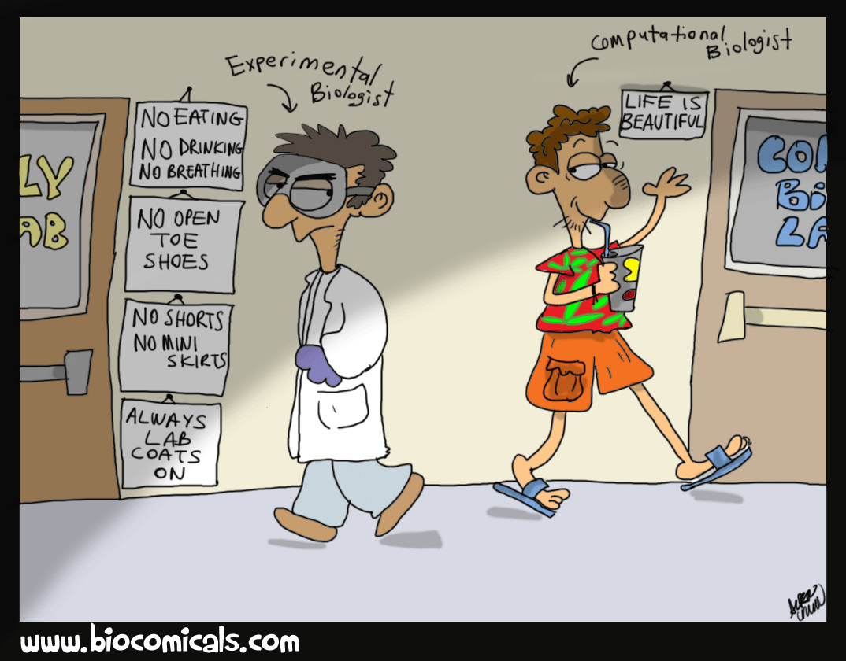

……..CENTRE OF EXCELLENCE
UNIVERSITY OF MAIDUGURI
MCB 204
BIOINFORMATICS
??????
CENTRE OF EXCELLENCE

Slide 2
UNIVERSITY OF MAIDUGURI CENTRE OF EXCELLENCE
Contents:
Introduction to Biological Databases ■
What is a Database? ■
Biological Databases ■
Types of Biological Databases ■
Applications of Biological Databases ■

Slide 3
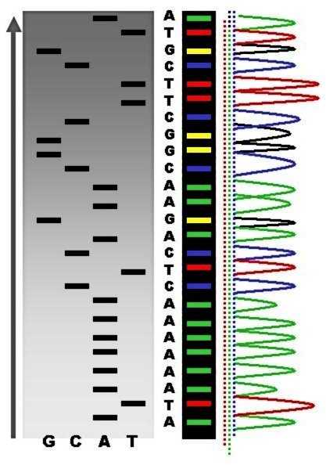
UNIVERSITY OF MAIDUGURI CENTRE OF EXCELLENCE
Introduction to Biological Databases
This chapter introduces some basic concepts related to
databases, in particular, the types and architectures of biological databases.
Emphasis is on retrieving data from the main biological databases such as GenBank.
Since the Phage Φ-X174 was sequenced in 1977, the DNA sequences of thousands of organisms have been decoded and stored in databases.

Slide 4
UNIVERSITY OF MAIDUGURI CENTRE OF EXCELLENCE
What is a Databases?
A database is a computerized archive used to store and organize data in such a way that information can be retrieved easily via a variety of search criteria.
Databases are composed of computer hardware and software for data management.
Data
Data is raw, unorganized facts need to be processed.
Example: Each students test score is one piece of data.
Information
When data is processed, organized structured or presented in a given context so as to make it useful it is called information.

Slide 5
UNIVERSITY OF MAIDUGURI CENTRE OF EXCELLENCE
Biological Databases?
Biological databases are libraries of life sciences information, collected from scientific experiments, published literature, high-throughput experiment technology, and computational analysis.
It consists of basic units called records or entries.
Biological databases can be;
accessed, added, retrieved, manipulated and modified
Store, manage, connect and distribute data

Slide 6
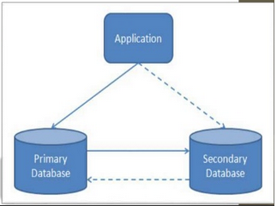
UNIVERSITY OF MAIDUGURI CENTRE OF EXCELLENCE
Types of Biological Databases
On the basis of source:
Primary databases
Secondary databases

Slide 7
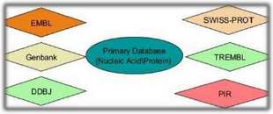
UNIVERSITY OF MAIDUGURI CENTRE OF EXCELLENCE
Primary Databases
They contains biomolecular data in its original form, i.e., original data in the form of primary sequence data or structural data submitted by the scientific community.
the data are essentially archival in nature.
Once a database accession no. is given to an kind of data in primary database then that data can’t be changed further.
Examples: GenBank, EMBL, DDBJ for DNA/RNA sequences.
SWISS – PROT, PFAM and PIR for protein sequences.

Slide 8
UNIVERSITY OF MAIDUGURI CENTRE OF EXCELLENCE
Nucleotide (DNA/RNA) sequences databases
Composed of a group of nucleotide sequence entries.
Data repositories that accept nucleic acid sequence data and make it freely available to the public.
GenBank, EMBL, DDBJ are principal nucleotide databases.
All the three are members of the International Nucleotide Sequence Database Consortium (INSDC) and interchange data.

Slide 9
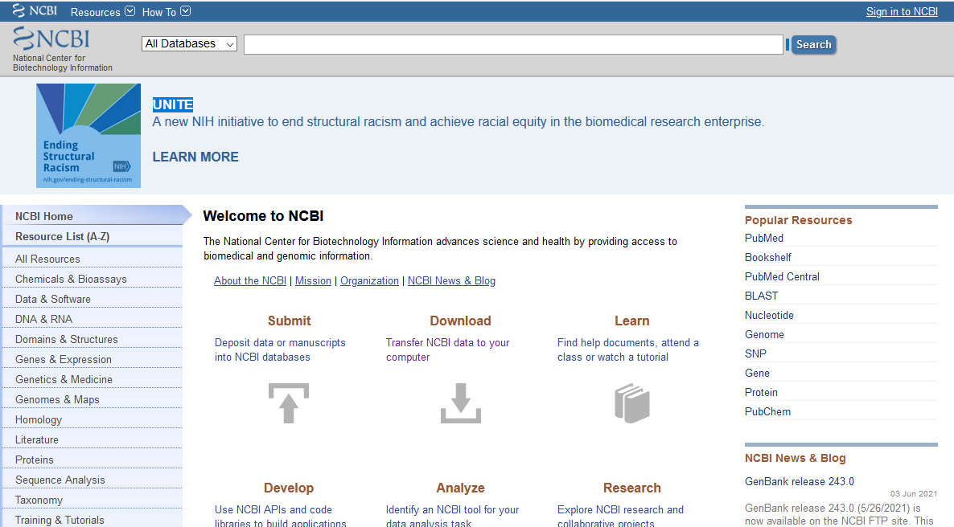
UNIVERSITY OF MAIDUGURI CENTRE OF EXCELLENCE
GenBank
It is a database from NCBI, situated at the campus of US National Institute of Health, USA.
includes sequences from publically available resources.
GenBank is the genetic sequence database, an annoted collection of all publically available DNA sequences.
information can be retrieved using the Entrez retrieval system.
www.ncbi.nlm.nih.gov/Genbank/

Slide 10
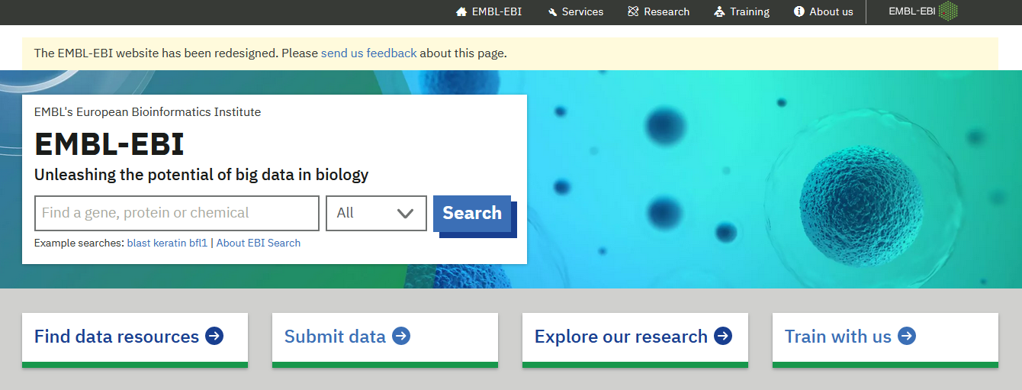
UNIVERSITY OF MAIDUGURI CENTRE OF EXCELLENCE
EMBL
European Molecular Biological Laboratory.
It is an Nucleic acid database that comes under EBI (European Bioinformatics Institute).
It was Established in collaboration with DDBJ and GenBank.
www.ebi.ac.uk/embl/

Slide 11
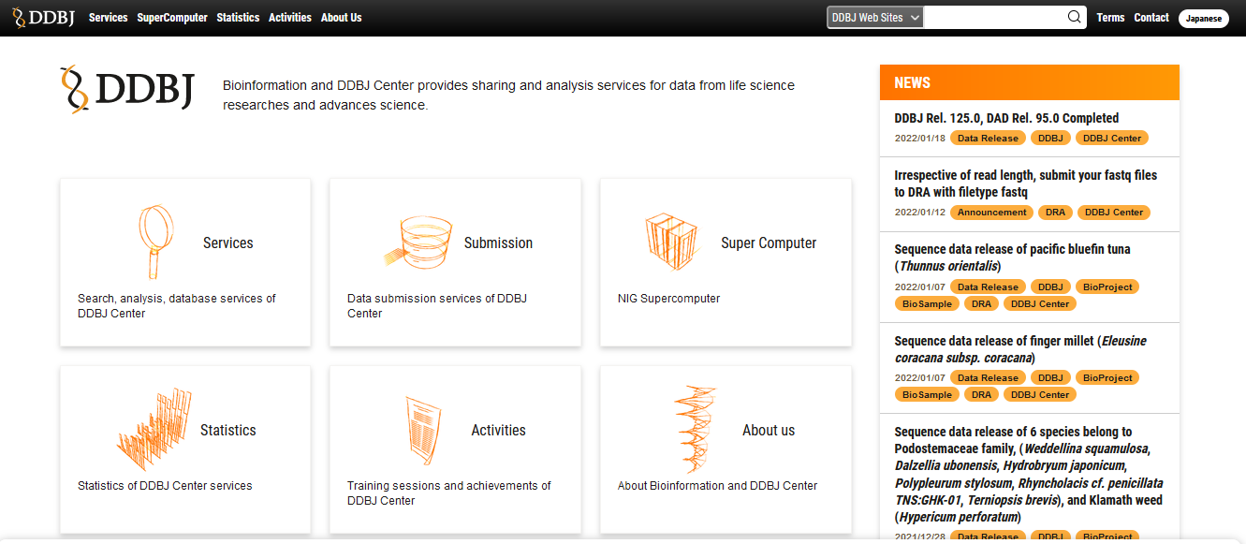
UNIVERSITY OF MAIDUGURI CENTRE OF EXCELLENCE
DDBJ
The DNA Data Bank of Japan is a biological database that collects DNA Sequences.
It is located at the National Institute of Genetics in the Shizuoka Prefecture of Japan.
It is also a member of the International Nucleotide Sequence Database Collaboration or INSDC.
www.ddbj.nig.ac.jp

Slide 12
UNIVERSITY OF MAIDUGURI CENTRE OF EXCELLENCE
Protein sequences databases
An array of amino acid sequence entries arranged according to the identification number.
Well known protein sequence databases available are
◦ Swiss-Prot
◦ PIR
PFAM
TREMBL
◦ UNIPROT

Slide 13
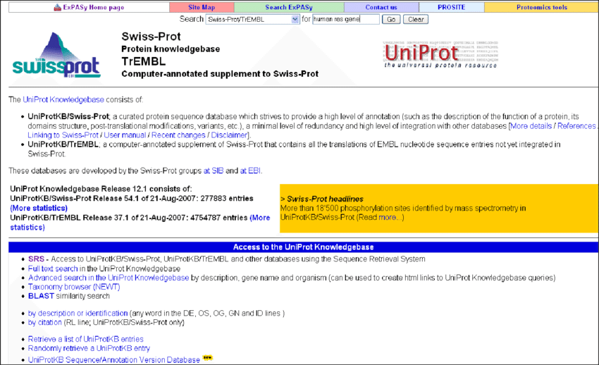
UNIVERSITY OF MAIDUGURI CENTRE OF EXCELLENCE
SWISS - PROT
SWISS – PROT is a curated protein sequence database which strives to provide a high level of annotation (such as description of the function of proteins, its domains structure, post translational modifications, variants, etc.). It provide all known relevant information about a particular protein.
SWISS – PROT was created in 1986 by Amos Bairoch with Swiss Institute of Bioinformatics and European Bioinformatics Institute(EBI).
www.ebi.ac.uk/swissprot/access.html

Slide 14
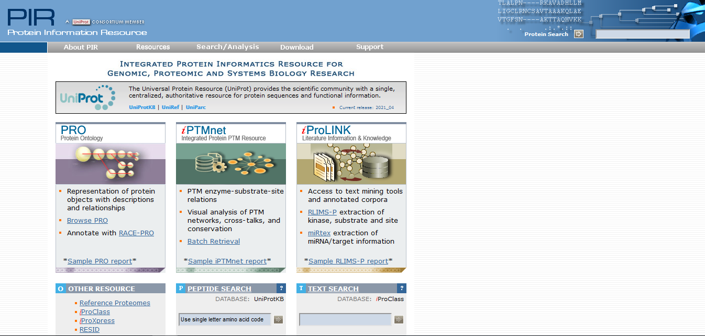
UNIVERSITY OF MAIDUGURI CENTRE OF EXCELLENCE
PIR
The Protein Information Resources (PIR) is an integrated public resource of protein informatics that supports genomic and proteomic research and scientific discovery.
PIR maintains the Protein Sequence Database (PSD), an annoted protein database containing over 283000 sequences covering the entire taxonomic range.
It assists researchers in the identification and interpretation of protein sequence information
http://pir.georgetown.edu/pirwww/pirhome3.shtml

Slide 15
UNIVERSITY OF MAIDUGURI CENTRE OF EXCELLENCE
Protein structure database
Many proteins which exhibit a common evolutionary origin, show structural similarities.
Dissimilar proteins exhibit changes in primary, secondary, tertiary and quaternary structures.
Similar or dissimilar protein structure can be predicted with structure database.
These databases store a collection of three dimensional structures of proteins.

Slide 16
UNIVERSITY OF MAIDUGURI CENTRE OF EXCELLENCE
The protein structural database including:
PDB ( protein data bank): comprises of :
i. PDBj ( PDB of Japan )
ii. PDBe ( PDB of Europe)
SCOPE: Structural classification of protein
CATH : Class Architecture Topology Homology
They all contains information generated from
i. X- Crystallography and
ii. NMR- spectroscopy Experiments.

Slide 17
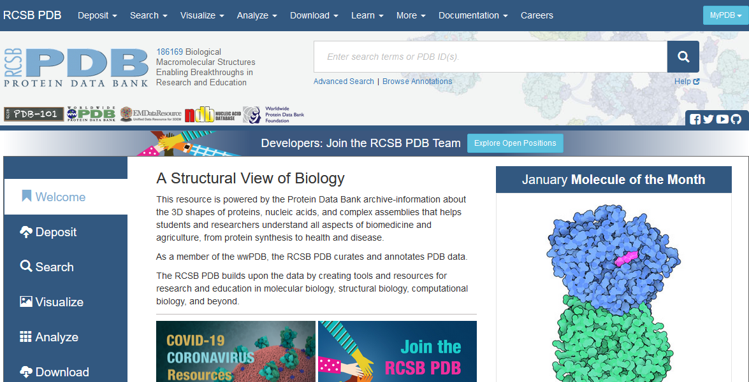
UNIVERSITY OF MAIDUGURI CENTRE OF EXCELLENCE
PDB
Understanding the shape of a molecule helps to understand how it works.
PDB is the main primary database used for the prediction and repository of 3D Structures of proteins.
The data obtained from X-ray chrystallography and NMR-spectroscopy, are submitted to the PDB.
Then, these structures are annotated as per the depositors specifications.
http://www.pdb.org/

Slide 18
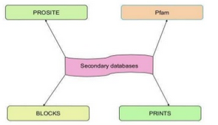
UNIVERSITY OF MAIDUGURI CENTRE OF EXCELLENCE
Secondary Database
It contains data derived from results of analyzed primary data ie, results of analysis of primary databases (information that has been processed and derived from in primary database)
The data in secondary database is either manually created or generated automatically.
It contains some valuable information such as about mutations or evolutionary relationship.

Slide 19
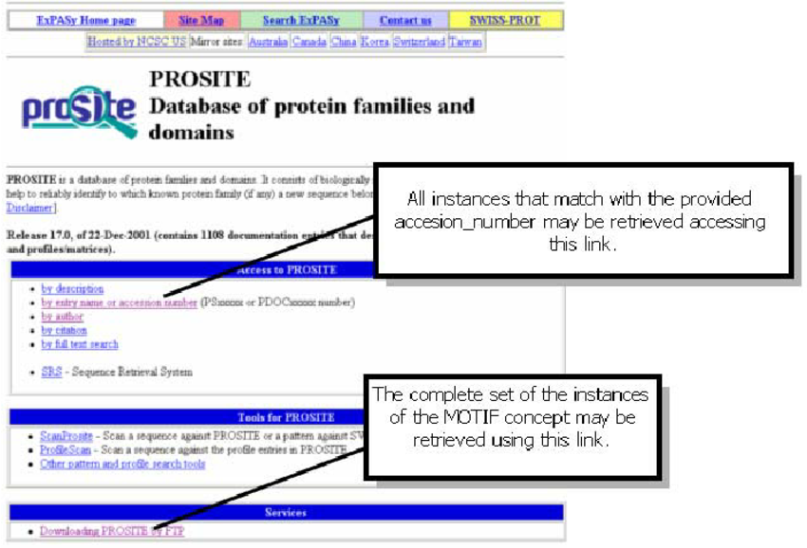
UNIVERSITY OF MAIDUGURI CENTRE OF EXCELLENCE
PROSITE
PROSITE is a protein database.
It consist of entries describing the protein families, domains and functional sites as well as amino acid patterns and profiles in them.
They are manually curated by a team of the Swiss Institute of Bioinformatics and tightly integrated into Swiss prot protein annotation.

Slide 20
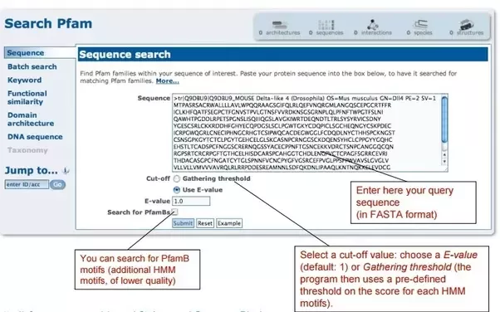
UNIVERSITY OF MAIDUGURI CENTRE OF EXCELLENCE
pfam
Pfam is a database of protein families that includes their annotations and multiple alignments generated using hidden markov models.
The general purpose of the pfam database is to provide a complete and accurate classification of protein families and domains.
Applications

Slide 21
UNIVERSITY OF MAIDUGURI CENTRE OF EXCELLENCE
Other Specialized Databases
HGMD : Human gene mutation database
OMIM: Online mutation inheritance in man (Disease database)
TRANSFAE: Trancription Factors database (Eukaryotic TF database)
RFAM: RNA family Database.

Slide 22
UNIVERSITY OF MAIDUGURI CENTRE OF EXCELLENCE
Applications
The major application of these database is that they can be sharable world wide.
The contains information about genome and protein of every species.
The primary database provide natural form of data so work as initial or beginning point in any research.
They also contains information of mutations and evolutionary relationships.

