Slide 1

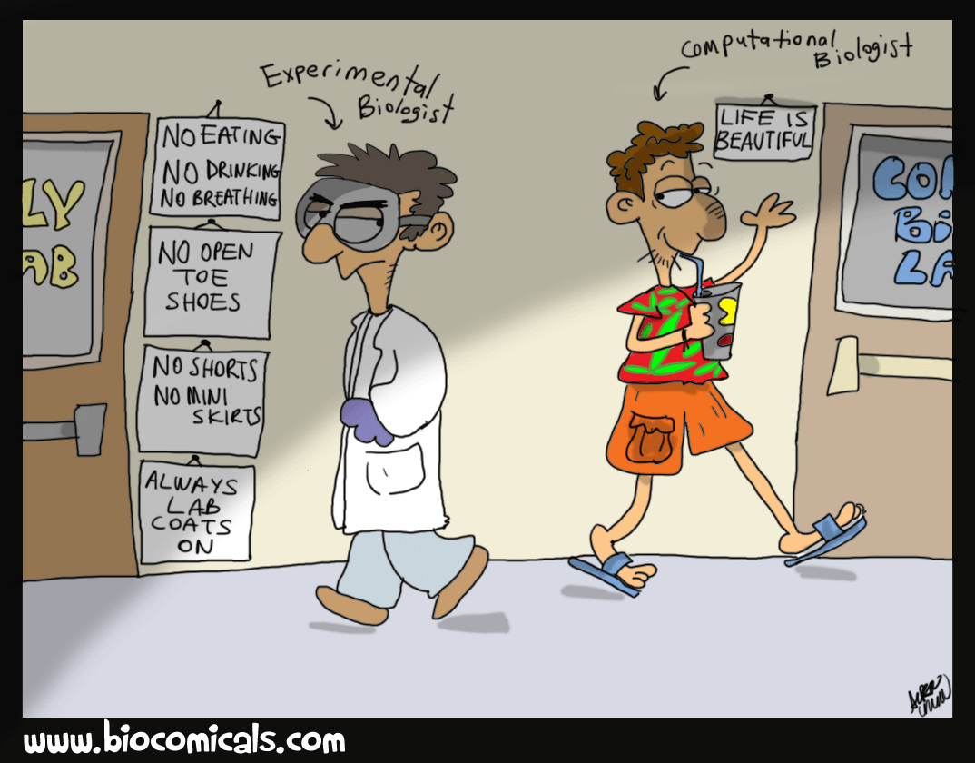

……..CENTRE OF EXCELLENCE
UNIVERSITY OF MAIDUGURI
MCB 204
BIOINFORMATICS
??????
CENTRE OF EXCELLENCE

Slide 2
UNIVERSITY OF MAIDUGURI CENTRE OF EXCELLENCE
Contents:
What is Bioinformatics ■
History of Bioinformatics■
Relation to other Fields■
Goal ■
Scope ■
Applications ■

Slide 3
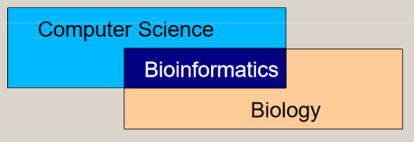
UNIVERSITY OF MAIDUGURI CENTRE OF EXCELLENCE
What is Bioinformatics
General Definition: A computational approach to solves the biological problem.
Application of techniques from computer science to problems from biology.

Slide 4
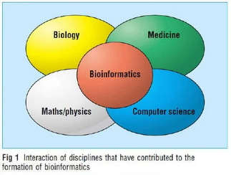
UNIVERSITY OF MAIDUGURI CENTRE OF EXCELLENCE
Bioinformatics is the use of computers for the acquisition, management, and analysis of biological information (DNA and amino acid sequences and related information).
It incorporates elements of molecular biology, computational biology, database computing, and the internet…
… bioinformatics is clearly a multi-disciplinary field including: computer systems management networking, database design, computer programming, molecular biology
Bioinformatics is a multifaceted discipline combining many scientific fields including computational biology, statistics, mathematics, molecular biology and genetics.

Slide 5
UNIVERSITY OF MAIDUGURI CENTRE OF EXCELLENCE
Bioinformatics is the application of tools of computation and analysis to the capture and interpretation of biological data.
It is the emerging field that deals with the application of computers to the collection, organization, analysis, manipulation, presentation, and sharing of biologic data to solve biological problems on the molecular level.
Bioinformatics is essential for management of data in modern biology
Bioinformatics develops algorithms and biological software of computer to analyze and record the data related to biology for example the data of genes, proteins, drug ingredients and metabolic pathways.
As biological data is always in raw form and there is a need of certain storage house in which the data can be stored, organized and manipulated.
The bioinformatics toolbox includes computer software program such as BLAST, which depend on the availability of the internet.

Slide 6
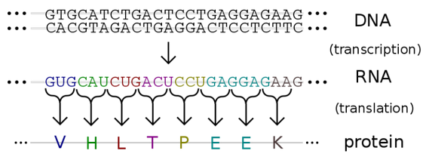
UNIVERSITY OF MAIDUGURI CENTRE OF EXCELLENCE
The stored data is available in the form of sequences and structures of proteins and nucleic acids (the information carrier).
The biological information of nucleic acids is available as sequences while the data of proteins is available as sequences and structures.
Sequences are represented in single dimension where as the structure contains the three dimensional data of sequences.
Difference between DNA and proteins sequence

Slide 7
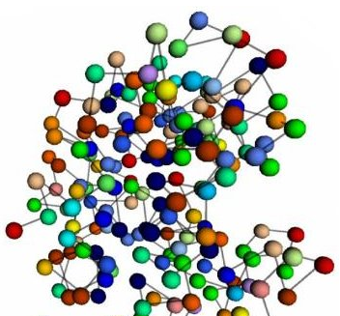
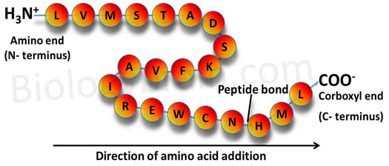
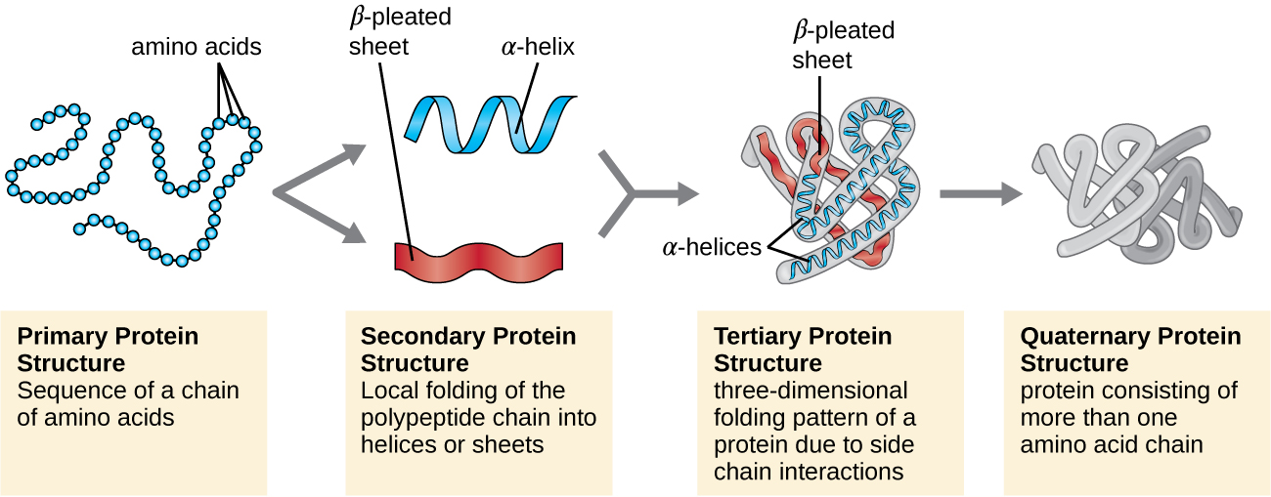
UNIVERSITY OF MAIDUGURI CENTRE OF EXCELLENCE
Proteins primary sequence
3D structure
Proteins structures

Slide 8
UNIVERSITY OF MAIDUGURI CENTRE OF EXCELLENCE
History of Bioinformatics
Historically, the term bioinformatics did not means what it means today. Paulien Hogeweg and Ben Hesper coined it in 1970 to refer to as the study of information processes in biotic system.
Comparing multiple sequences manually turned out to be impractical. A pioneer in the field was Margaret Oakley Dayhoff, who has been hailed by David Lipman, director of the National Center for Biotechnology Information, as the “mother and father of bioinformatics”.
Dayhoff compiled one of the first protein sequence database, initially published as books and pioneered methods of sequence alignment and molecular evolution.
Another early contributor to bioinformatics was Elvin A. Kabat, who pioneered biological sequence analysis in 1970 with his comprehensive volumes of antibody sequences released with Tai Tei Wu between 1980 and 1991.
The first biological database - Protein Identification Resource was established in 1972 by Margaret Dayhoff
Dayhoff and co-workers organized the proteins into families and superfamilies based on degree of sequence similarity.

Slide 9
UNIVERSITY OF MAIDUGURI CENTRE OF EXCELLENCE
Idea of sequence alignment was introduced as well as special tables that reflected the frequency of changes observed in the sequences of a group of closely related proteins
1973 - The Brookhaven Protein Data Bank(PDB) is announced. Currently there are several huge Protein Banks : SwissProt, PIR, etc.
The first DNA database was established in 1979. Currently there are several powerful databases: GenBank, EMBL, DDBJ, etc.
Development of sequence retrieval methods (1970-80s)
Development of principles of sequence alignment (1980s)
Prediction of RNA secondary structure (1980s)
1988 - National Centre for Biotechnology Information (NCBI) founded at NIH/NLM.
Prediction of protein secondary structure and 3D (1980-90s)
The FASTA and BLAST methods for DB search (1980-90s). BLAST program introduced by S. Karlin and S.F. Altshul.
Prediction of genes (1990s)
1990 - Human Genome Project launched.

Slide 10
UNIVERSITY OF MAIDUGURI CENTRE OF EXCELLENCE
Tim Berners-Lee, a British scientist invented the World Wide Web in 1990.
Studies of complete genome sequences (late 1990s –2–2000s)
2001 - The human genome (3,000 Mbp) is published.
2010 :Completion of the 2010 Project: to understand the function of all genes within their cellular, organism and evolutionary context of Arabidopsis thaliana.
2050: To complete of the first computational model of a complete cell, or maybe even already of a complete organism.

Slide 11
UNIVERSITY OF MAIDUGURI CENTRE OF EXCELLENCE
Relation to other Fields
Bioinformatics is similar to the but distinct from biological computation and computational biology.
Biological computation uses bioengineering and biology to build biological computers, whereas bioinformatics uses computation to better understand biology.
Computational Biology: the study and application of computing methods for classical biology. Primarily concerned with evolutionary, population and theoretical biology, rather than the cellular or molecular level.
Bioinformatics and computational biology have similar aims and approaches, but they differ in scale: bioinformatics organizes and analyzes basic biological data, whereas computational biology builds theoretical models of biological systems, just as mathematical biology does with mathematical models.

Slide 12
UNIVERSITY OF MAIDUGURI CENTRE OF EXCELLENCE
Other Related Field:
Medical Informatics;
The study and application of computing methods to improve communication, understanding, and management of medical data.
Generally concerned with how the data is manipulated rather the data itself
Cheminformatics;
The study and application of computing methods, along with chemical and
biological technology, for drug design and development.
Genomics
Analysis and comparison of the entire genome of a single species or of multiple species.
A genome is the set of all genes possessed by an organism.
Genomics existed before any genomes were completely sequenced, but in a very primitive state.

Slide 13
UNIVERSITY OF MAIDUGURI CENTRE OF EXCELLENCE
Proteomics
Study of how the genome is expressed in proteins, and of how these proteins function and interact.
Concerned with the actual states of specific cells, rather than the potential states described by the genome.
Pharmacogenomics
The application of genomic methods to identify drug targets.
For example, searching entire genomes for potential drug receptors, or by studying gene expression patterns in tumors
Pharmacogenetics
The use of genomic methods to determine what causes variations in individual response to drug treatments.
The goal is to identify drugs that may be only be effective for subsets of patients, or to tailor drugs for specific individuals or groups.

Slide 14
UNIVERSITY OF MAIDUGURI CENTRE OF EXCELLENCE
Goals of Bioinformatics
The primary goal of bioinformatics is to increase the understanding of biological processes.
bioinformatics organizes data in a way that allows researchers to access existing information and to submit new entries as they are produced
develop tools and resources that aid in the analysis of data
to use these tools to analyze the data and interpret the results in a biologically meaningful manner.

Slide 15
UNIVERSITY OF MAIDUGURI CENTRE OF EXCELLENCE
Scope of Bioinformatics
Major research efforts in the field includes:
Sequence alignment,
genome annotation,
analysis of mutations in cancer,
drug design,
drug discovery,
protein structure alignment,
protein structure prediction,
prediction of gene expression and protein-protein interactions, genome-wide association studies, the modeling of evolution and cell division/mitosis

Slide 16
UNIVERSITY OF MAIDUGURI CENTRE OF EXCELLENCE
Applications of Bioinformatics
Bioinformatics joins mathematics, statistics and computer science and information technology to solve complex biological problems. These problems are usually at the molecular level which cannot be solved by other means.
This interesting field of science has many applications. This include:
Preventative medicine
Genomics
Gene therapy
Drug design
Diagnosis of disease
Drug discovery
Prediction of Protein Structure
Genome Annotation
Comparative Genomics
Molecular phylogenies

Slide 17
UNIVERSITY OF MAIDUGURI CENTRE OF EXCELLENCE
Preventative medicine
Gene identification by sequence inspection and prediction of splice sites allows mutations to be corrected easily.
This is much used in the analysis of mutations that cause cancer.
Applications
Pharmacogenomics
Not all drugs work on all patients, some good drugs cause death in some patients.
So by doing a gene analysis before the treatment the offensive drugs can be avoided.
Customized treatment
Gene Therapy
Replace or supply the defective or missing gene
E.g: Insulin and Haemophilia
Mutations are easily detected and quantified through next-generation sequencing technology in a heterogeneous sample thus a cost effective precision medicine, “right drug at right dose to the right patient at the right time” can be administered

Slide 18
UNIVERSITY OF MAIDUGURI CENTRE OF EXCELLENCE
Diagnosis of disease
Identification of genes which cause the disease will help detect disease at early stage e.g. Huntington disease
Drug Design:
Can go up to 15yrs and $700million
One of the goals of bioinformatics is to reduce the time and cost involved with it.
The process
–Discovery
–Computational methods can improves this
–Testing

Slide 19
UNIVERSITY OF MAIDUGURI CENTRE OF EXCELLENCE
Drug Discovery:
The tools of bioinformatics are also helpful in drug discovery.
Complete sequencing of human genes has enabled the scientists to make medicines and drugs which can target more than 500 genes.
Target identification
–Identifying the molecule on which the germs relies for its survival
–Then we develop another molecule i.e. drug which will bind to the target
– So the germ will not be able to interact with the target.
– Proteins are the most common targets
For example HIV produces HIV protease which is a protein and which in turn eat other proteins
This HIV protease has an active site where it binds to other molecules
So HIV drug will go and bind with that active site
–Easily said than do

Slide 20
UNIVERSITY OF MAIDUGURI CENTRE OF EXCELLENCE
Prediction of Protein Structure:
It is easy to determine the primary structure of proteins in the form of amino acids which are present on the DNA molecule but it is difficult to determine the secondary, tertiary or quaternary structures of proteins.
Tools of bioinformatics can be used to determine the complex protein structures.
Genome Annotation:
In genome annotation, genomes are marked to know the regulatory sequences and protein coding.
It is a very important part of the human genome project as it determines the regulatory sequences.
Comparative Genomics:
Comparative genomics is the branch of bioinformatics which determines the genomic structure and function relation between different biological species.
For this purpose, intergenomic maps are constructed which enable the scientists to trace the processes of evolution that occur in genomes of different species.

